Slide 1
Chapter 10:
Sinusoidal Steady-State Analysis
1

Slide 2
Objectives :
‒ To introduce sinusoidal functions
‒ Define impedance
‒ To use phasors to determine the forced response of a circuit subjected to sinusoidal excitation
‒ To apply techniques using phasors

Slide 3
Introduction:
Characteristics of Sinusoids:
V_{m}: is the amplitude of the sine wave.
ωt : is the argument.
ω: is the radian frequency, or angular frequency.

Slide 4
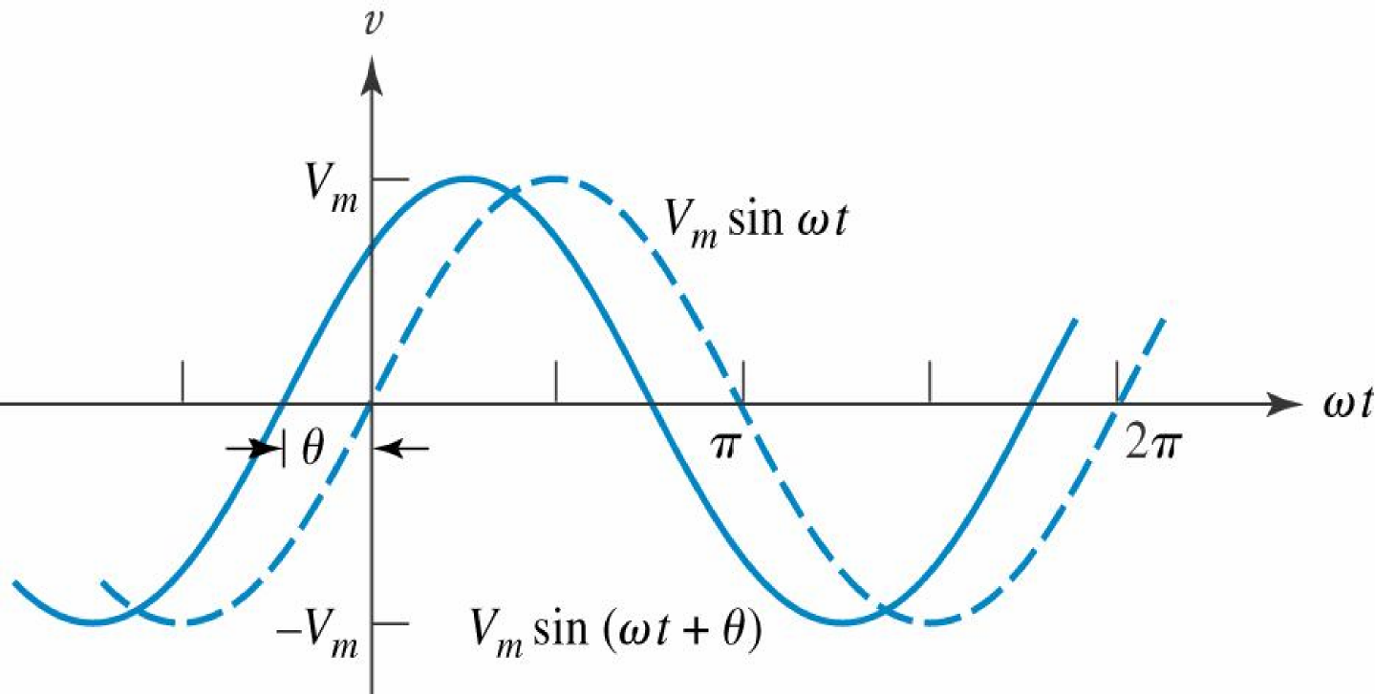
Lagging and leading signals :
‒ A more general form of the sinusoid, includes a phase angle θ in its argument.
V_{m} sin(ωt + θ) leads V_{m} sinωt by θ rad.
‒ In either case, leading or lagging, we say that the sinusoids are out of phase.
‒ If the phase angles are equal, the sinusoids are said to be in phase.

Slide 5
Lagging and leading signals:
In electrical engineering, the phase angle is commonly given in degrees, rather than radians
v = 100 sin(2π1000t − π/6)
instead of writing
v = 100 sin(2π1000t − 30◦)
we customarily use
v = 100 sin(0.2π − 30◦)
At t = 10⁻⁴ s
v = 100 sin(36º − 30◦)
= 100 sin(6º) =10.45
θ (radian) = θ (degree)* π/180
θ (degree) = θ (radian)* 180/ π

Slide 6
Lagging and leading signals:
Two sinusoidal waves whose phases are to be compared must:
1. Both be written as sine waves, or both as cosine waves.
2. Both be written with positive amplitudes.
3. Each have the same frequency.
‒ Normally, the difference in phase between two sinusoids is expressed by that angle which is less than or equal to 180 degree in magnitude
‒ The sine and cosine are essentially the same function, but with a 90° phase difference. Thus, sin ωt = cos(ωt − 90°).
Note that:
−sinωt = sin(ωt ± 180°)
−cosωt = cos(ωt ± 180°)
∓sinωt = cos(ωt ± 90°)
±cosωt = sin(ωt ± 90°)

Slide 7
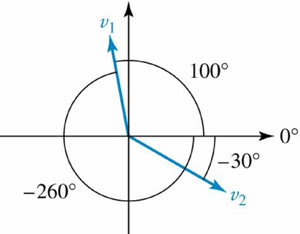
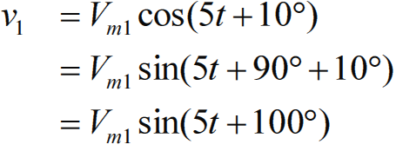
Lagging and leading: Example
v₁ = V_{m1} cos(5t + 10°)
v₂ = V_{m2} sin(5t − 30°)
v₂ leads v₁ by -130° or v₂ lags v₁ by 130°.
v₁ leads v₂ by 130° or v₁ lags v₂ by -130°.
It is also correct to say that v₁ lags v₂ by 230°, since v₁ may be written as v₁ = V_{m1} sin(5t − 260°)

Slide 8
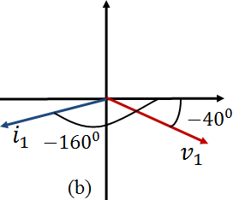
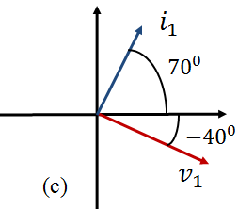
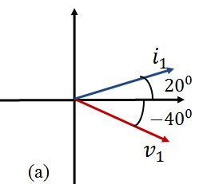
Practice: 10.1
Find the angle by which i₁ lags v₁

Slide 9
Practice: 10.2
Find A, B, C, and φ if
40 cos(100t − 40◦) − 20 sin(100t + 170◦)
= A cos 100t + B sin 100t = C cos(100t + φ).

Slide 10
The Complex Function:
‒ A relationship between time-varying sinusoidal functions and complex numbers is Euler's equation, which for our purposes is written as
‒ This complex function has a real part and an imaginary part:
Recall that

Slide 11
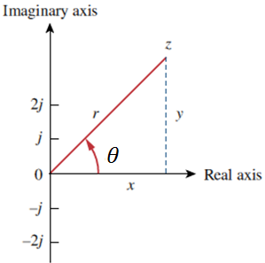
The Complex Function:
‒ A complex number z can be written in rectangular form as
x is the real part of z; y is the imaginary part of z.
‒ The complex number z can also be written in polar or exponential form as
‒ The relationship between the rectangular form and the polar form is shown in Fig

Slide 12
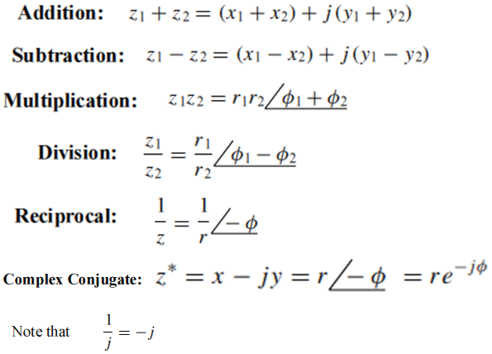
The Complex Function:
‒ z may be written as
Given the complex numbers

Slide 13
Practice: 10.4

Slide 14
The Complex Function:
‒ The idea of phasor representation is based on Euler’s identity. In general,
‒ Given a sinusoid
V is thus the phasor representation of the sinusoid v(t)

Slide 15
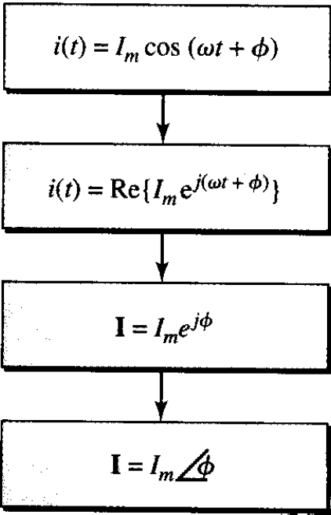
Phasor: Page 24
A phasor transformation:

Slide 16
Practice:

Slide 17
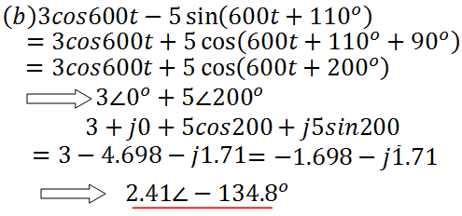
Practice:

Slide 18
Practice:
Transform from frequency domain into time domain

Slide 19
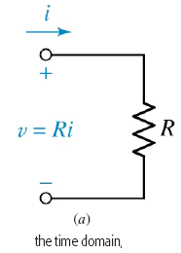
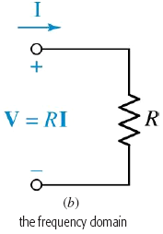
Phasor Relationship:
The resistance R
let us assume that a voltage of 8 cos(100t − 50◦) V is across a 4 resistor. Working in the time domain, we find that the current must be

Slide 20
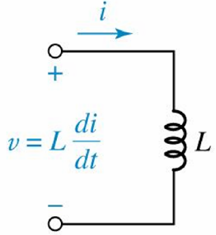
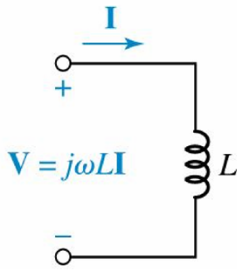
Phasor Relationship:
The inductance L
Example

Slide 21
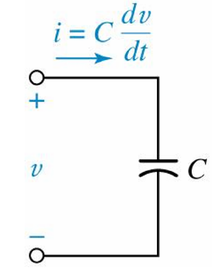
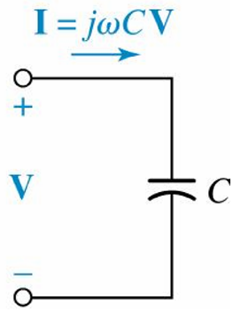
Phasor Relationship:
The Capacitor C

Slide 22
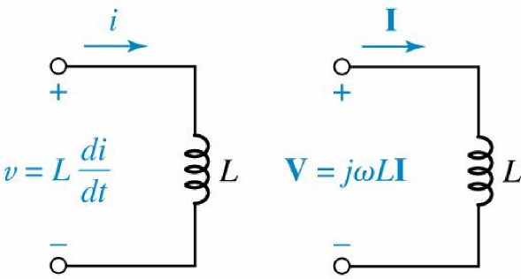
Phasor Relationship:

Slide 23
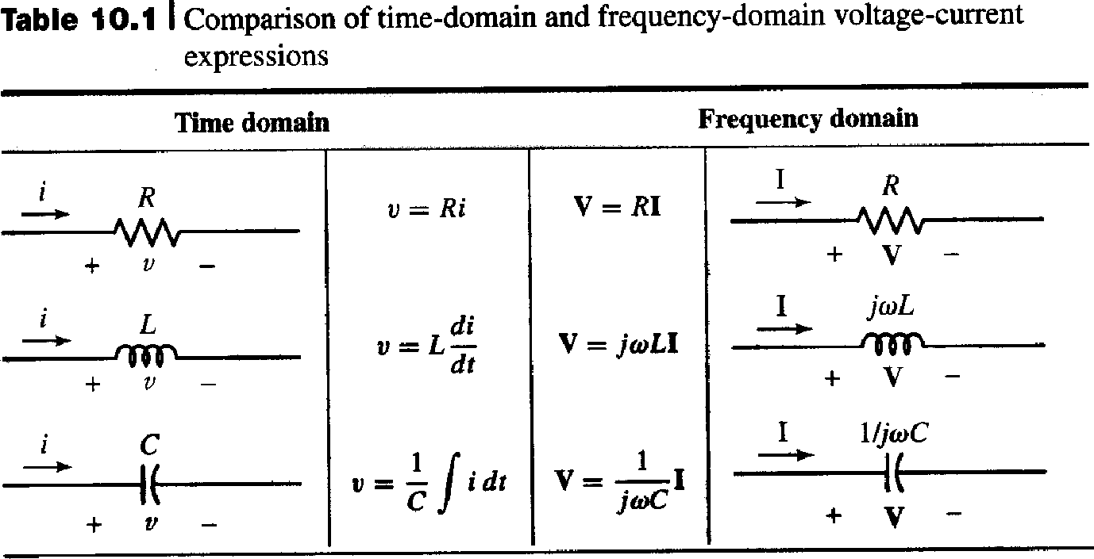
Phasor Relationship:

Slide 24
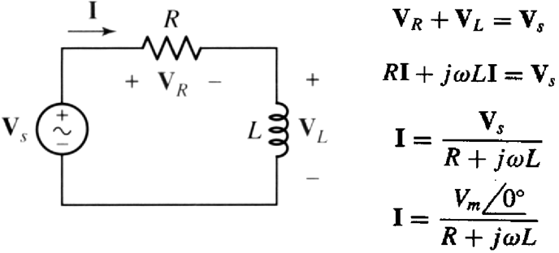
Phasor:

Slide 25
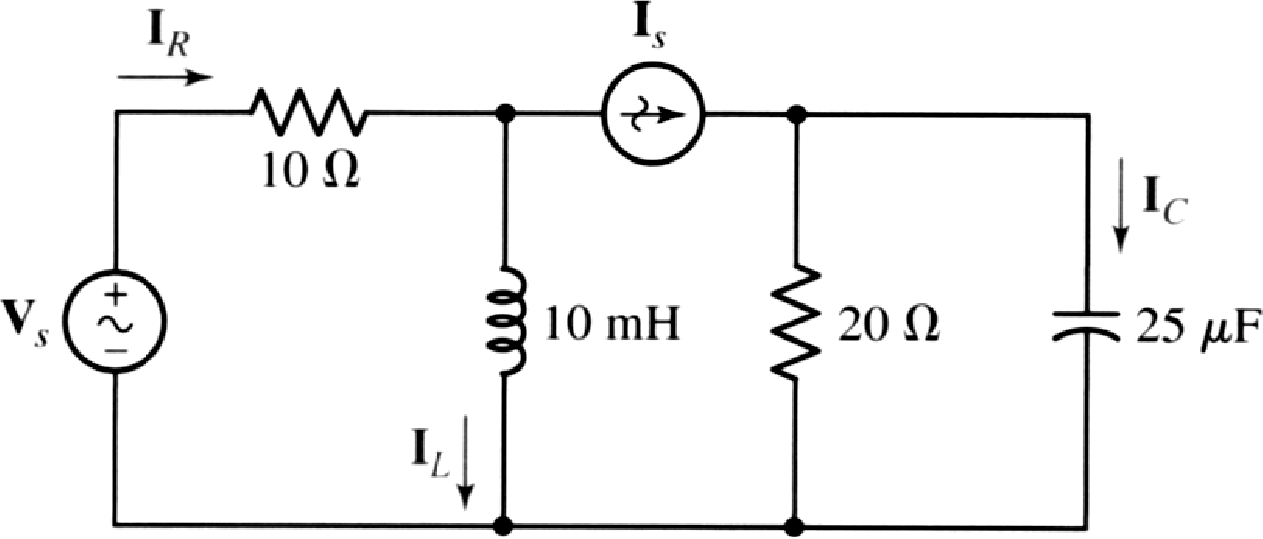
Practice: 10.8

Slide 26
Practice: 10.8

Slide 27
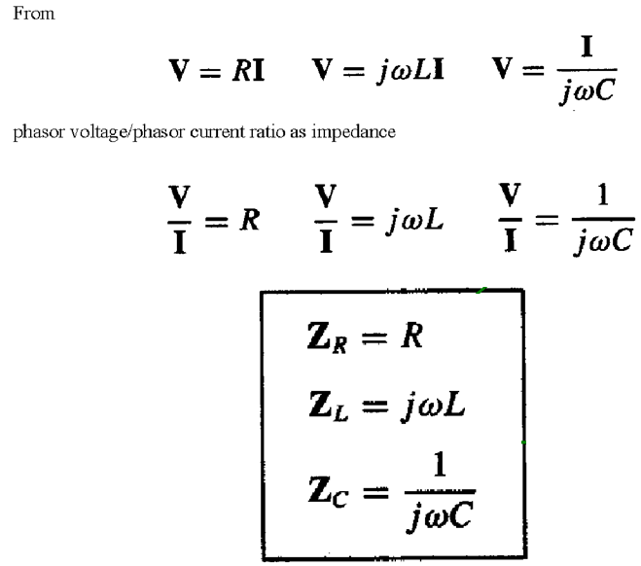
Impedance: Z

Slide 28
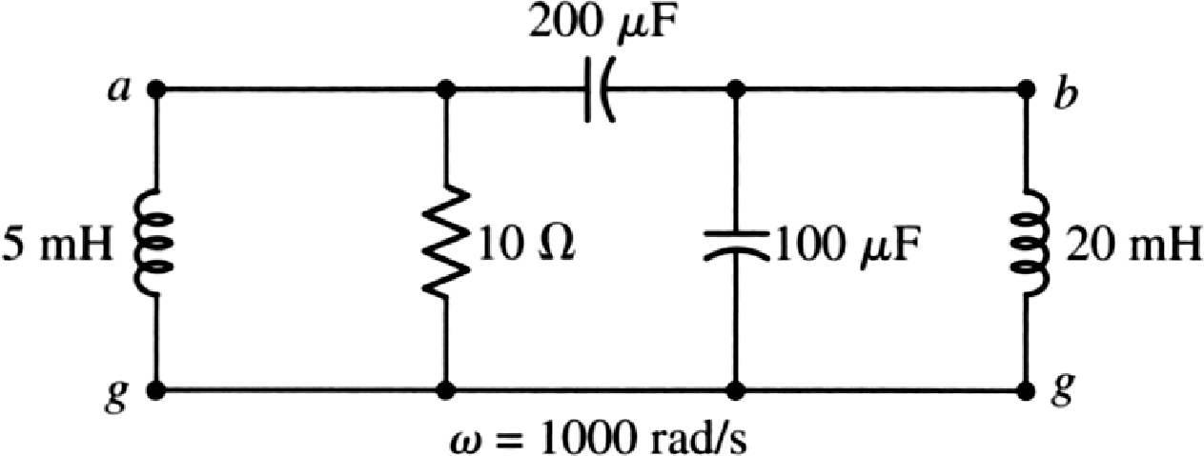
Practice: 10.9
With reference to the network shown, find the input
impedance that would be measured between
terminals: (a) a and g; (b) b and g; (c) a and b

Slide 29
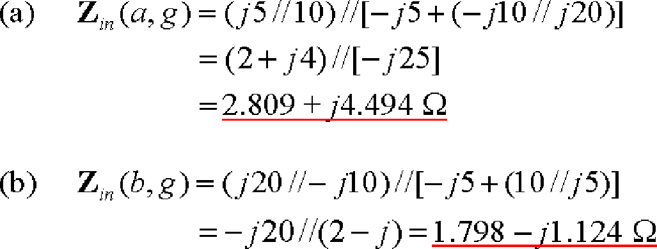
Practice: 10.9

Slide 30
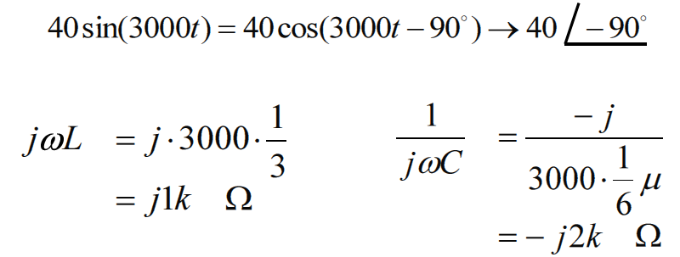
Example: Find i(t)

Slide 31
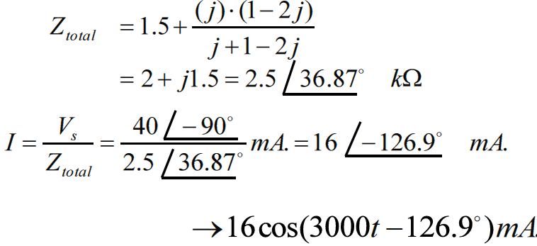
Example: Find i(t)

Slide 32
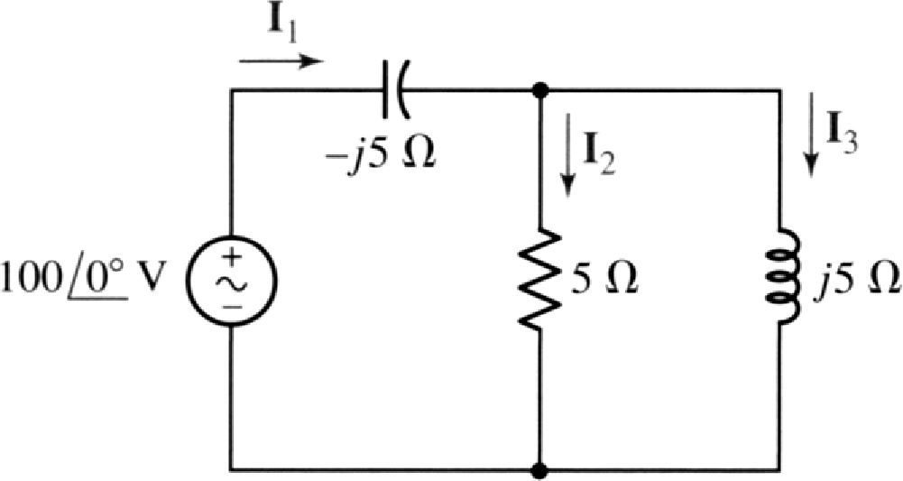
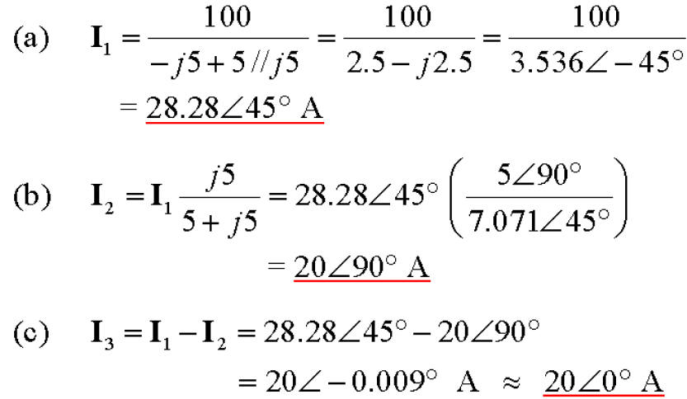
Practice 10.10:
In the frequency-domain circuit, find (a) I₁; (b) I₂; (c) I₃

Slide 33
Nodal and Mesh Analysis:
Example: find v1(t) and v2(t)

Slide 34
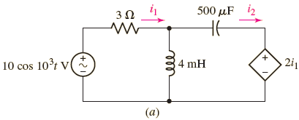
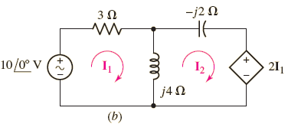
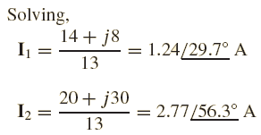
Nodal and Mesh Analysis:
Example: Using mesh analysis, find i1(t) and i2(t)

Slide 35
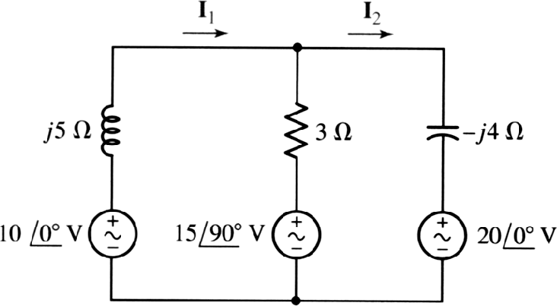
Nodal and Mesh Analysis:
Example: Using mesh analysis, find I1 and I2

Slide 36
Superposition:
Use superposition to find V1 for the following circuit

Slide 37
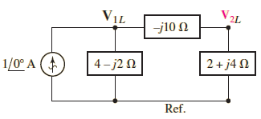
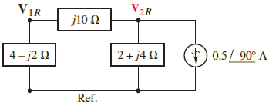
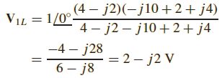
Superposition:
Use superposition to find V1 for the following circuit

Slide 38
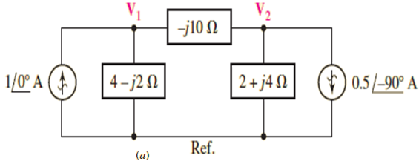
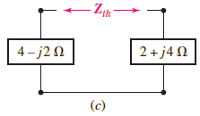
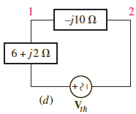
Thevenin and Norton equivalent CCT:
Determine the Thévenin equivalent seen by the −j10 impedance in the following Figure and use this to compute V1.

Slide 39
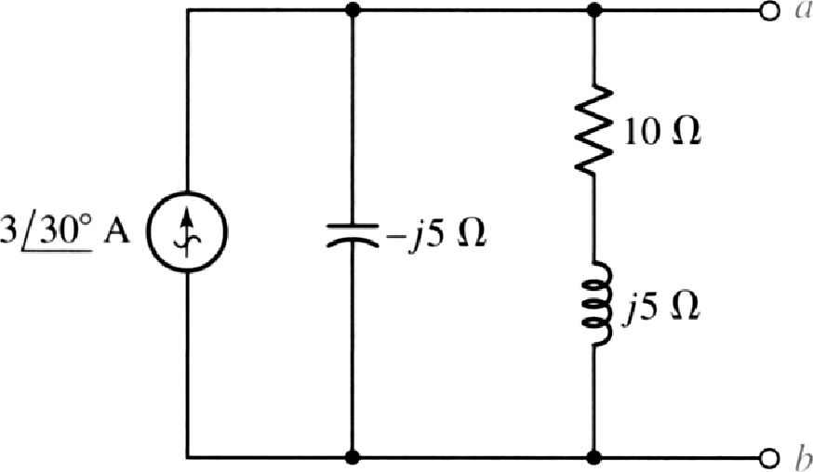
Practice: 10.15
For the circuit, find the
(a) open-circuit voltage V_{ab};
(b) downward current in a short circuit between a and b;
(c) Thevenin-equivalent impedance Z_{ab} in parallel with the current source.

Slide 40
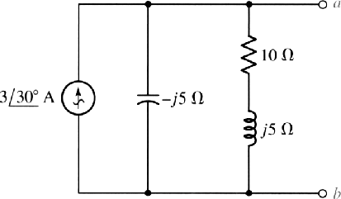
Practice: 10.15

Slide 41
Practice: 10.16
Determine the current through the 4-i) resistor

Slide 42
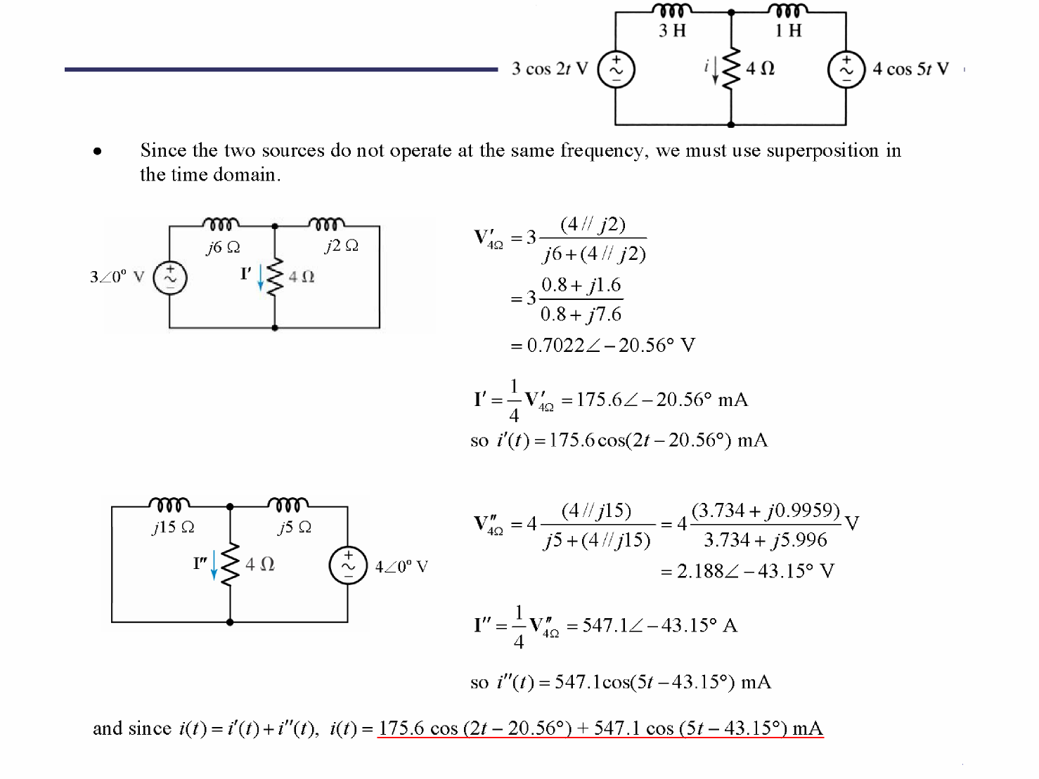
Practice: 10.16

