Slide 1
Chapter 3:
Voltage and Current Laws

Slide 2
Objectives :
Definition of nodes, paths, loops, and branches
Kirchhoff’s current law (KCL)
Kirchhoff’s voltage law (KVL)
Analyzing simple series and parallel circuits
Simplify series and parallel connected sources
Reducing series and parallel resistor combinations
Voltage and current division
2

Slide 3
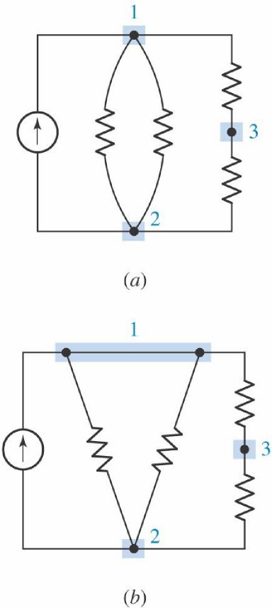
Nodes, Paths, Loops, and Branches:
Node: A point at which two or more elements have a common connection is called a node.
Path: a set of nodes and elements that we pass through without passing through a node more than once is defined as a path.
Loop: If the node at which we started is the same as the node on which we ended, then the path is, by definition, a closed path or a loop.
Branch: is a single path in a network, composed of one simple element and the node at each end of that element.
3

Slide 4
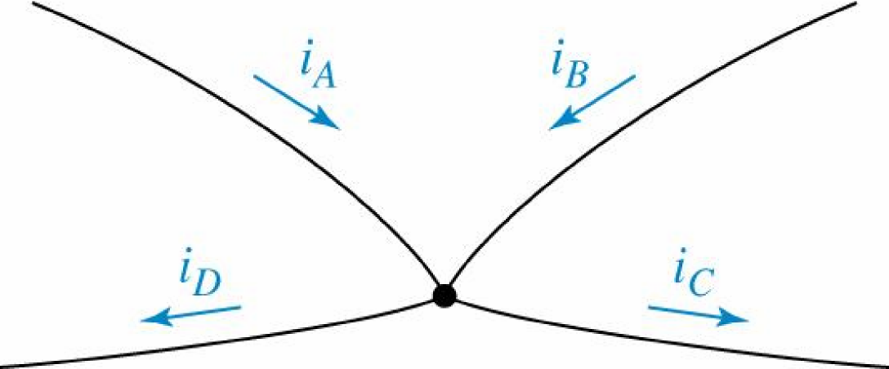
Kirchhoff's Current Law (KCL):
The algebraic sum of the currents entering any node is zero
4

Slide 5
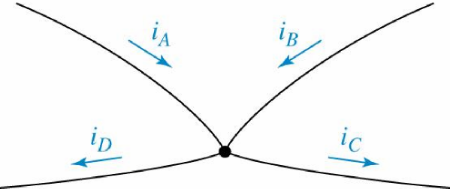
Kirchhoff's Current Law (KCL):
5

Slide 6
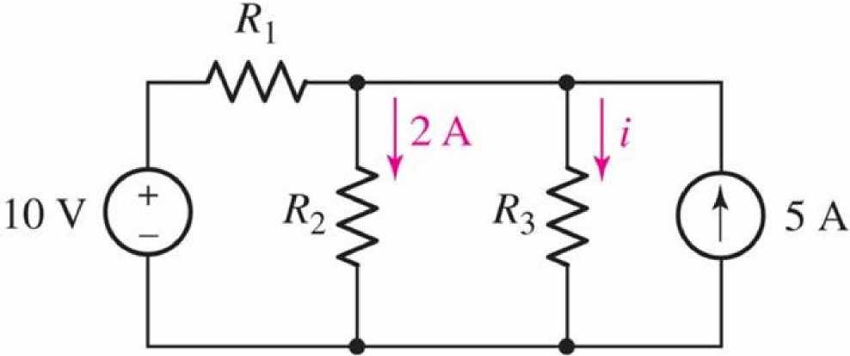
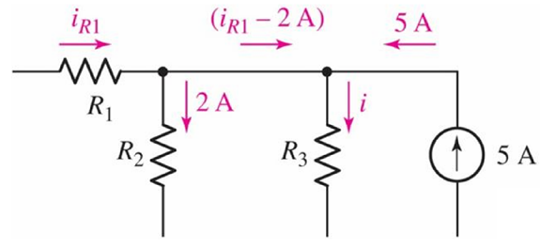
Example: 3.1
Compute the current through resister R3 if it is
known that the voltage source supplies a
current of 3 A.
6

Slide 7
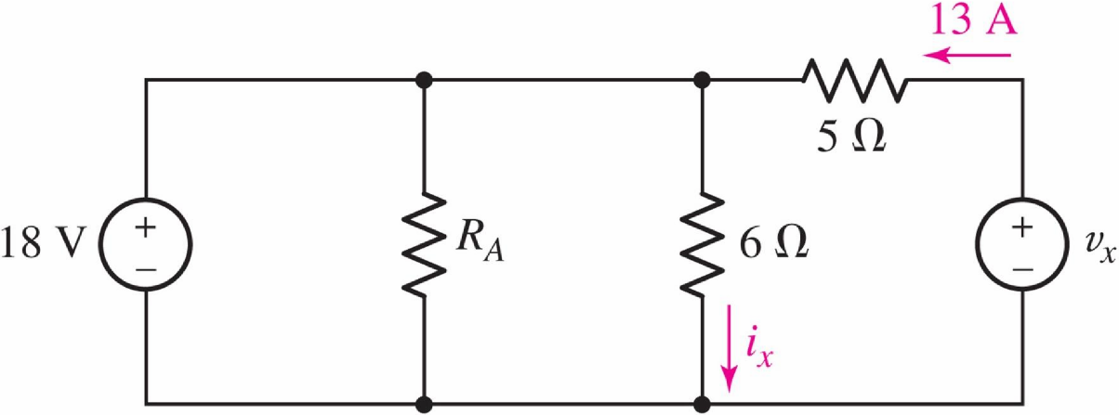
Practice: 3.1
Count the number of branches and nodes in the
circuit. If i_{x} = 3 A. and the 18-V source delivers 8 A.
of current, what is the value of RA?
7

Slide 8
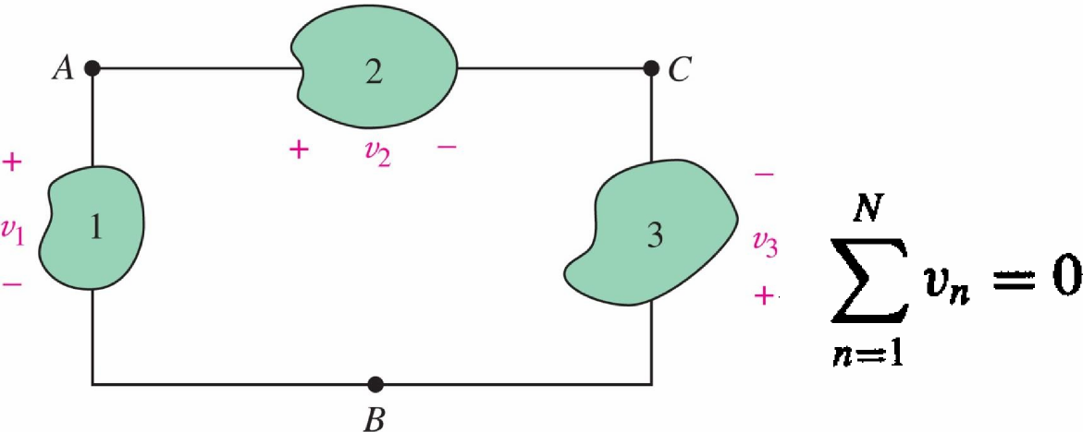
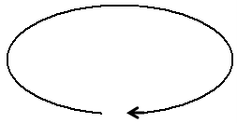
Kirchhoff's Voltage Law (KVL):
The algebraic sum of the voltages around any
closed path is zero
8

Slide 9
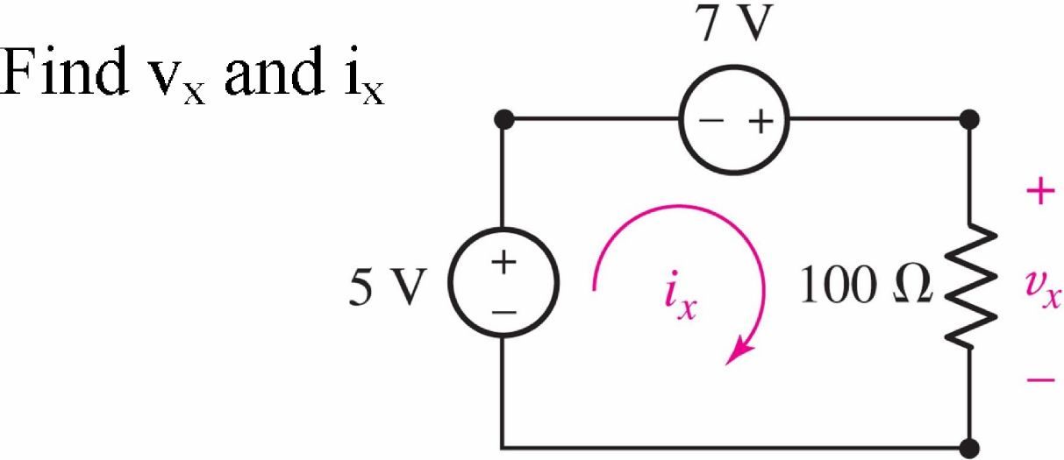
Example: 3.2
9

Slide 10
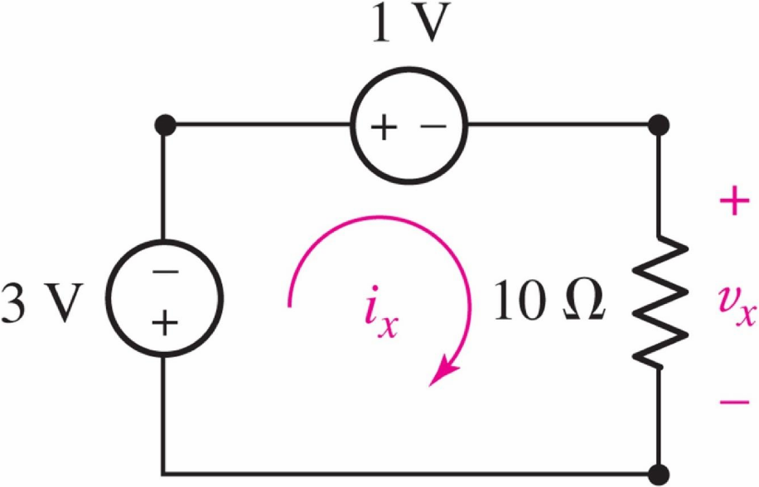
Practice: 3.2
Determine i_{x} and v_{x}
10

Slide 11
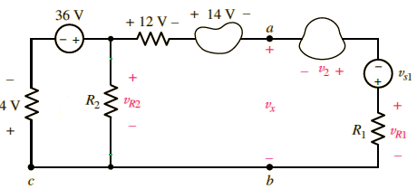
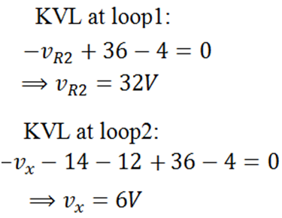
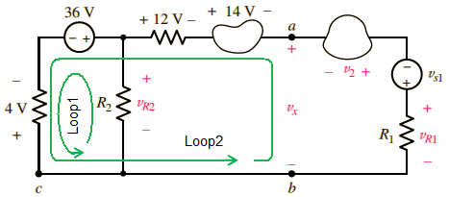
Example: 3.3
In the following circuit find and
11

Slide 12
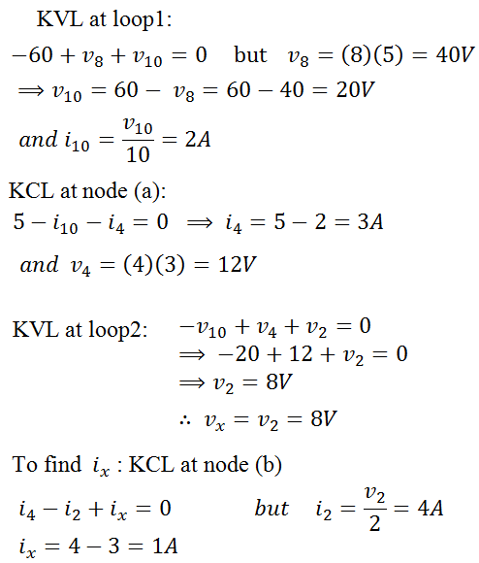
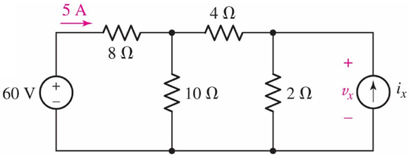
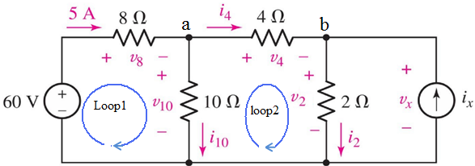
Example: 3.4
Find and in the following circuit
12

Slide 13
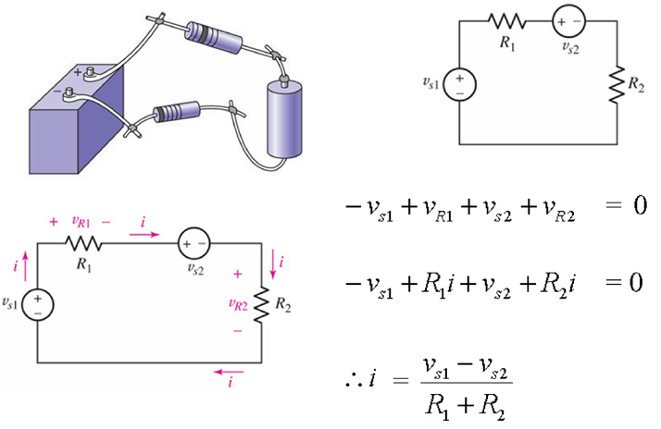
The Single Loop Circuit:
13

Slide 14
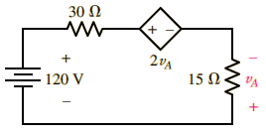
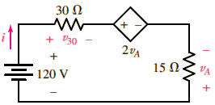
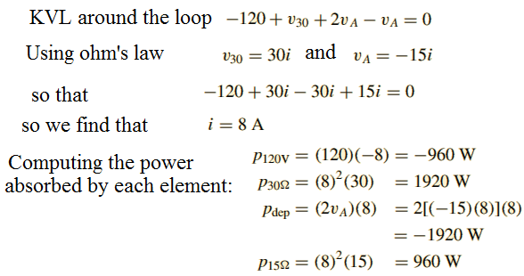
Example: 3.5
Compute the power absorbed in each element in the following circuit:
14

Slide 15
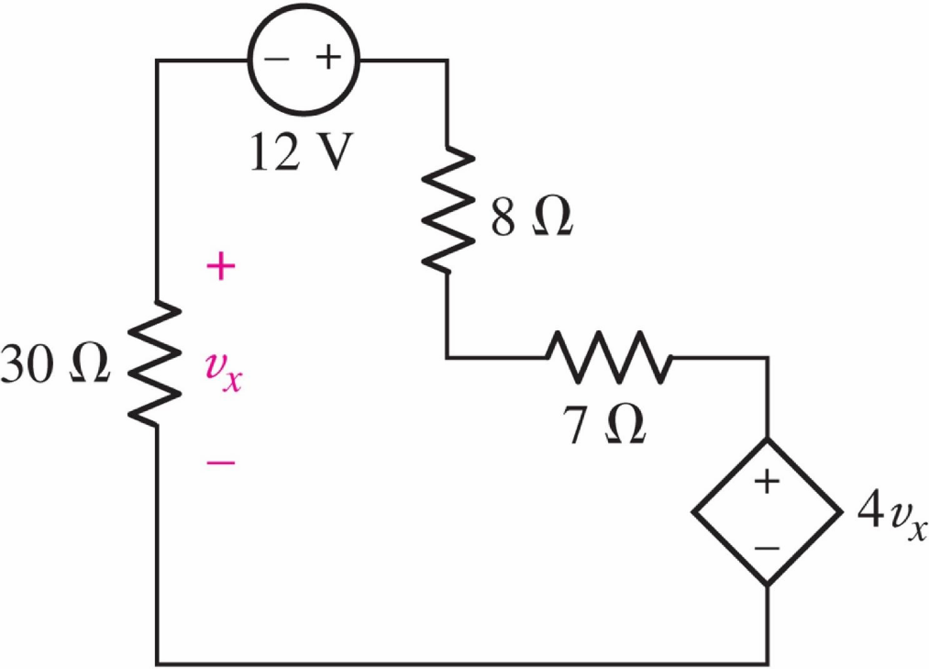
Practice: 3.5
Find the power absorbed by each of the five
elements in the circuit.
15

Slide 16
The Single Node-Pair Circuit:
16

Slide 17
Practice: 3.6
Determine v
17

Slide 18
Practice: 3.7
For the single-node-pair circuit of the figure,
find i_{A} , i_{B} and iC
18

Slide 19
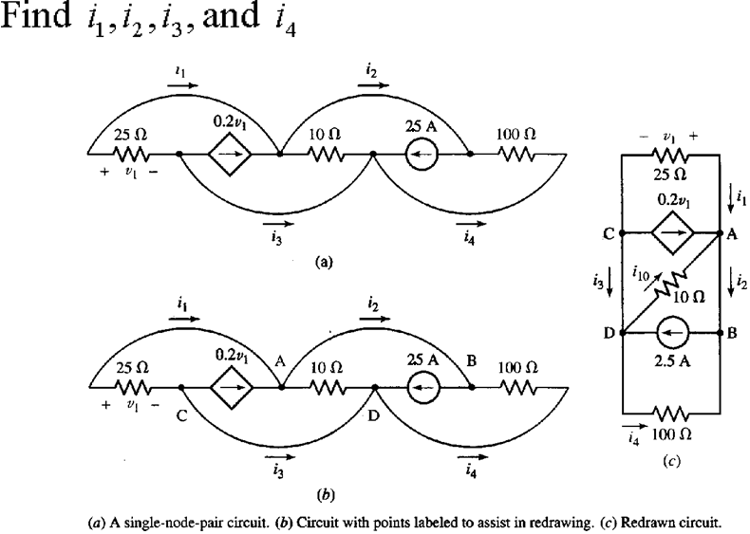
Example:
19

Slide 20
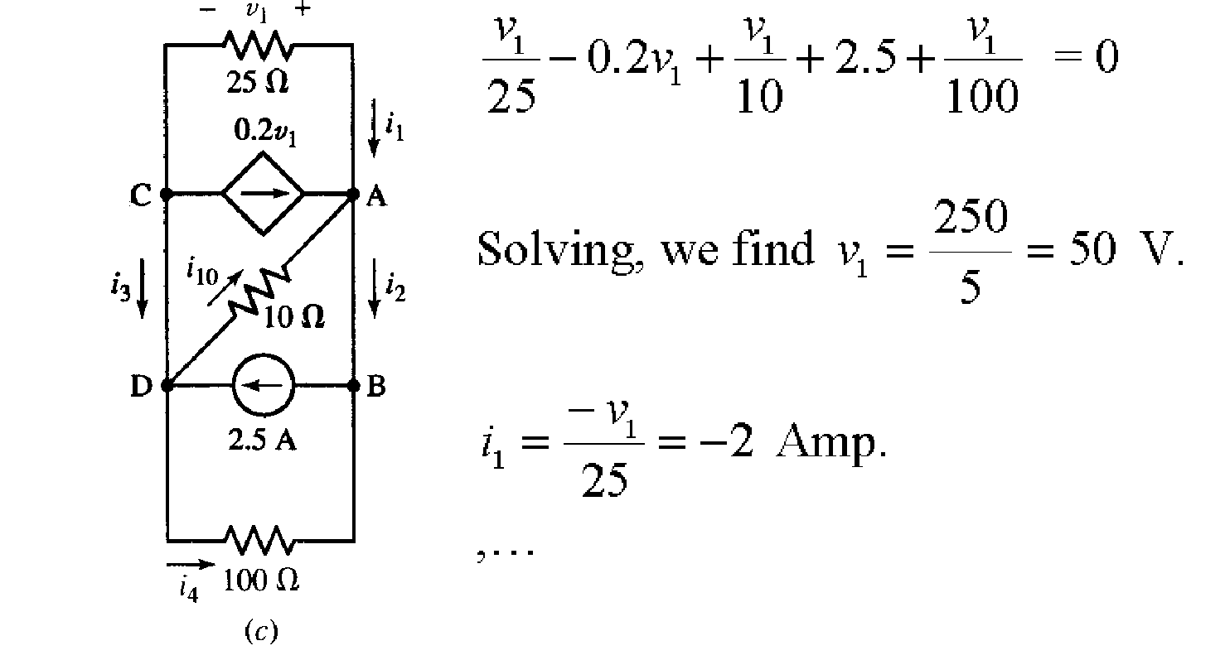
Example:
20

Slide 21
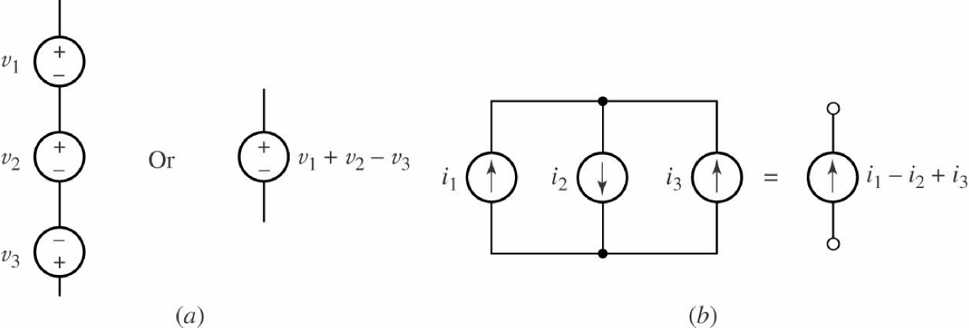
Series and Parallel Connected:
Independent Sources:
(a) Series connected voltage sources can be replaced by a
single source. (b) Parallel current sources can be replaced by a
single source.
21

Slide 22
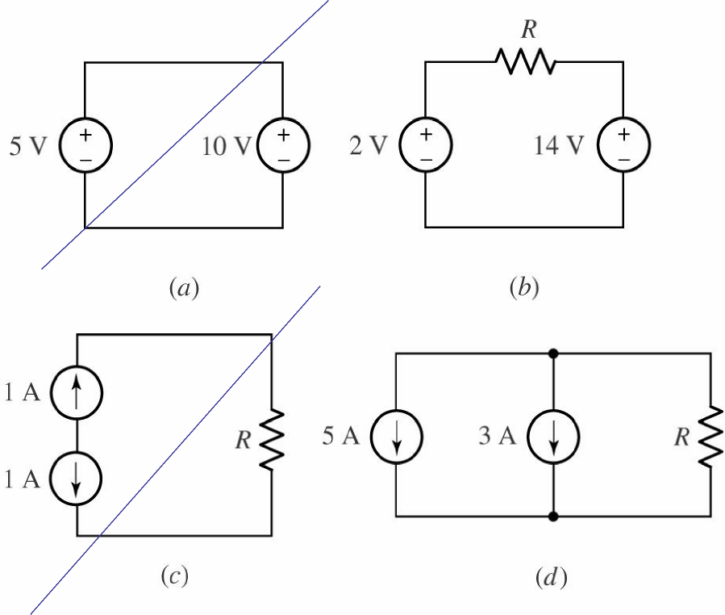
Practice:
Examples of circuits with multiple sources, some of which are “illegal” as they violate Kirchhoff’s laws.
22

Slide 23
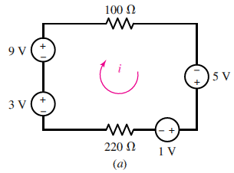
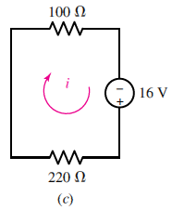
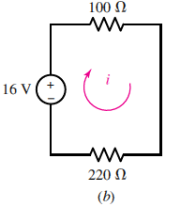
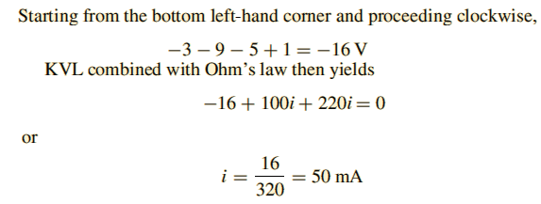
Example: 3.8
Determine the current i in the following circuit by first combining the sources into a single equivalent voltage source.
23

Slide 24
Practice:
Determine v in the circuit of the figure by first
combing the three current sources.
24

Slide 25
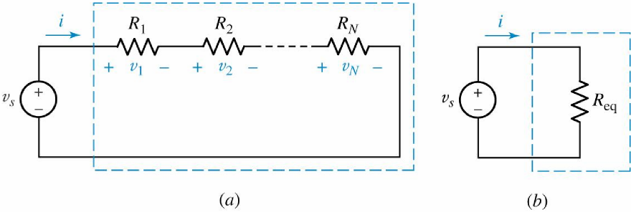
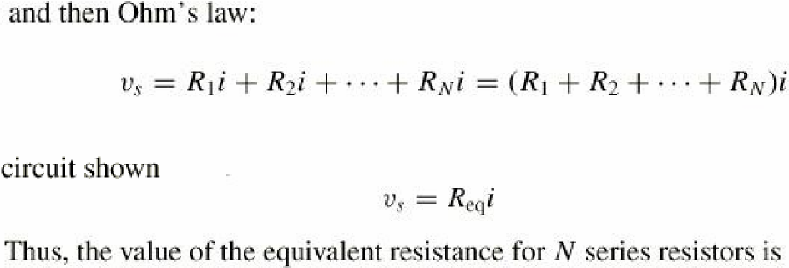
Resistors in Series and Parallel:
(a) Series combination of N resistors. (b) Electrically equivalent circuit.
25

Slide 26
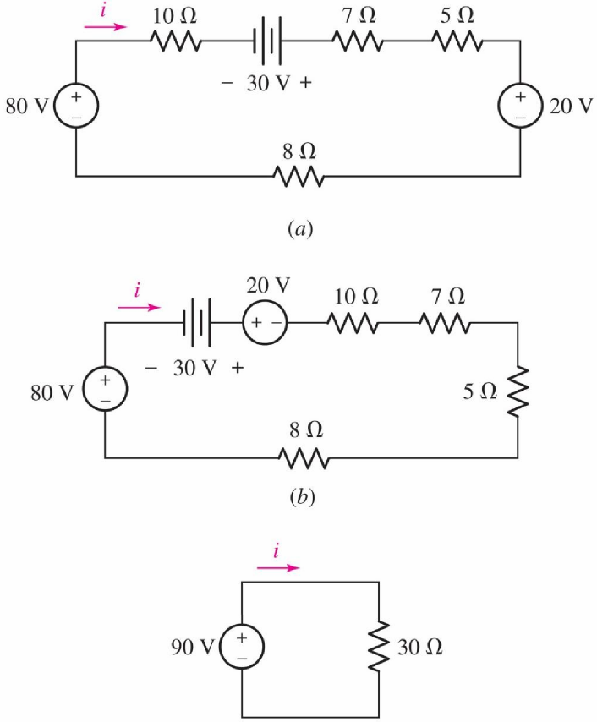
Resistors in Series and Parallel:
26

Slide 27
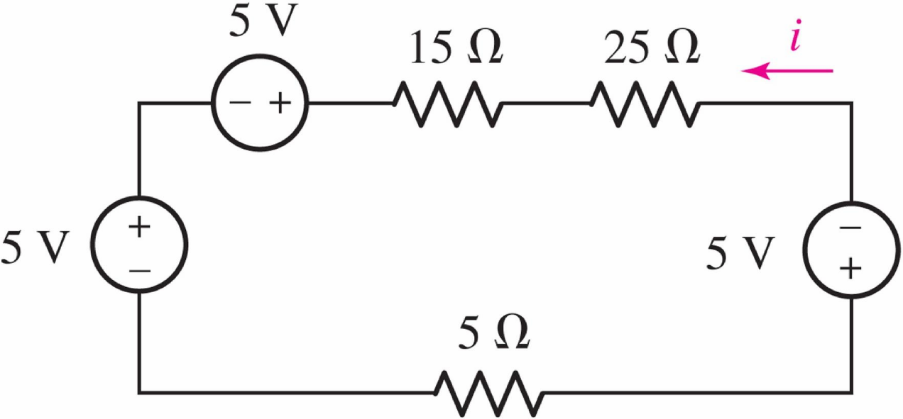
Practice:
Determine i in the circuit
27

Slide 28
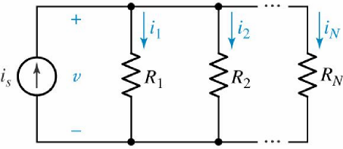
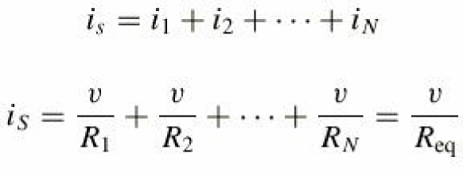
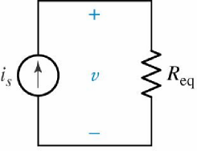
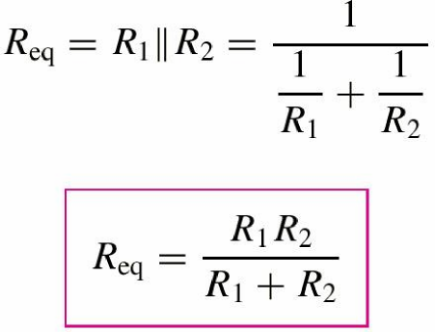
Resistors in Series and Parallel:
Beginning with a simple KCL equation,
 | or
Thus,
A special case worth remembering is
(a) A circuit with N resistors in parallel. (b) Equivalent circuit.
28

Slide 29
Practice:
Determine v in the circuit by first combing the
three current sources, and then the two 10 c
resistors.
29

Slide 30
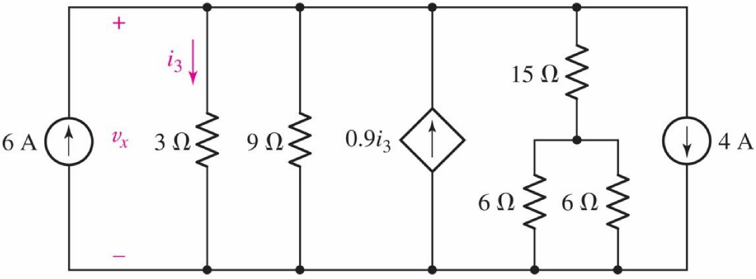
Example: 3.12
Calculate the power delivered by and voltage of the dependent source
30

Slide 31
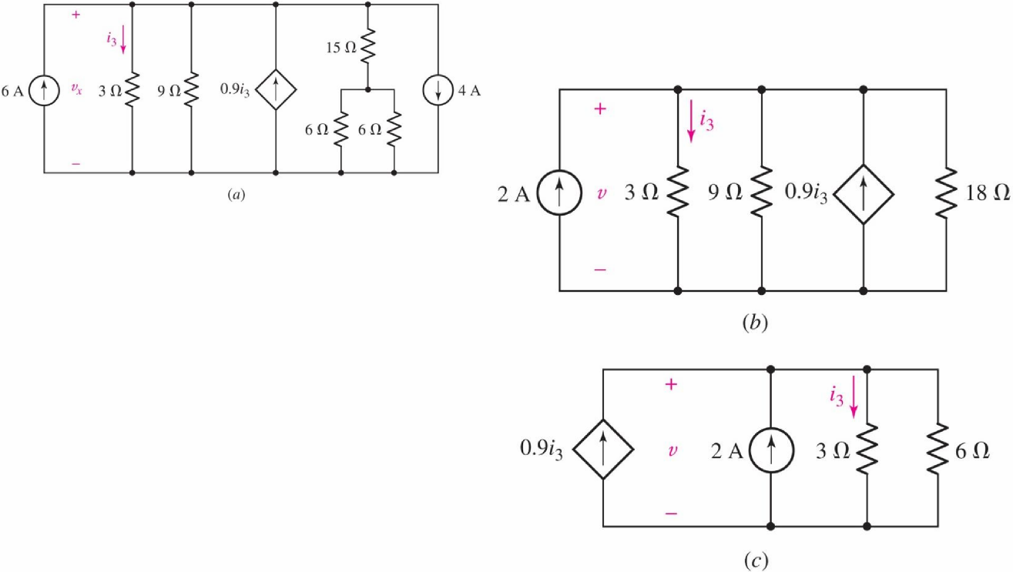
Example:3.12
Calculate the power delivered by and voltage of the dependent source
31

Slide 32
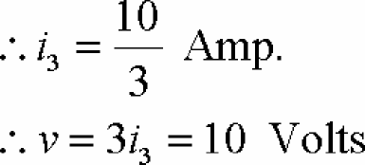
Example:3.12
Calculate the power delivered by and voltage of the dependent
source
the power delivered by the dependent current source is 30W
32

Slide 33
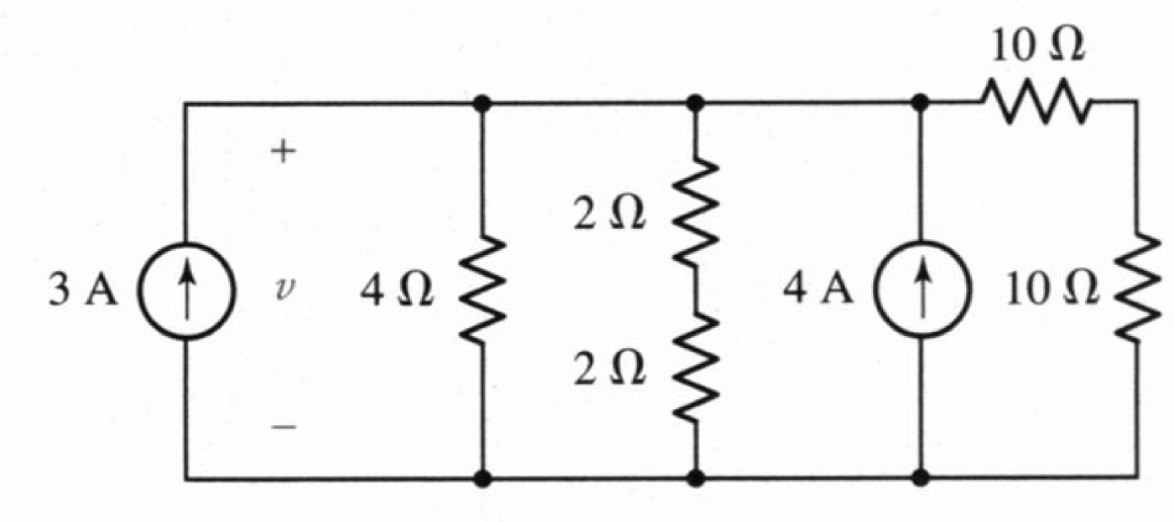
Practice:
Find the voltage v
33

Slide 34
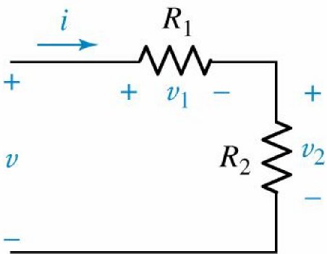
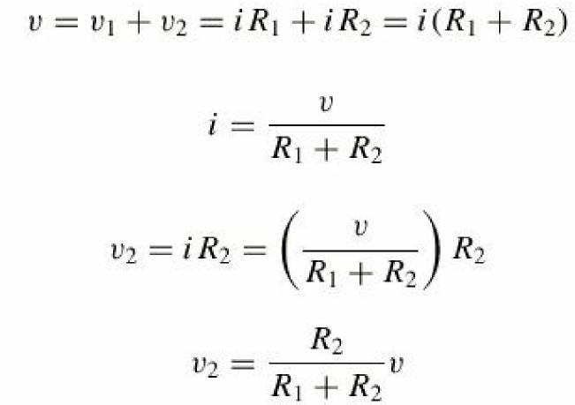
Voltage and Current division:
We may find by applying KVL and Ohm’s law:
so
Thus,
An illustration of
voltage division.
or
For a string of N series resistors, we
may write:
34

Slide 35
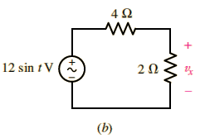
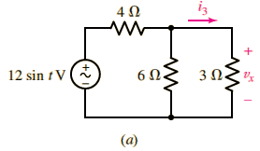
Example:3.13
35

Slide 36
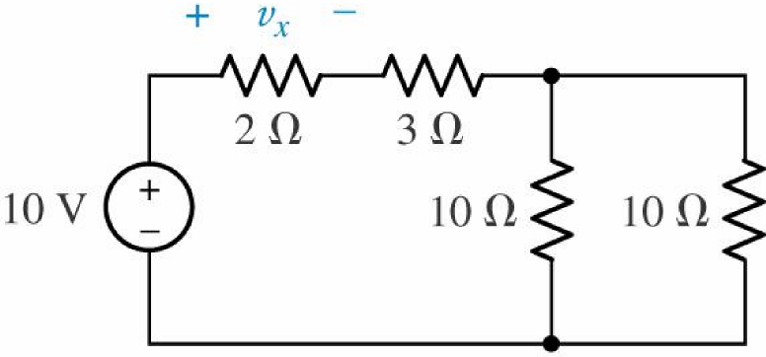
Voltage and Current division:
Use voltage division to
determine v_{x} in the adjacent
circuit.
36

Slide 37
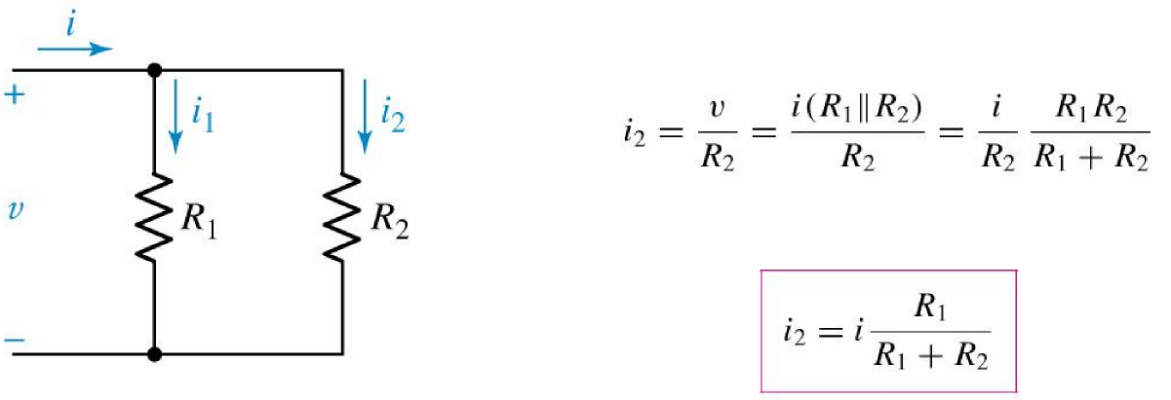
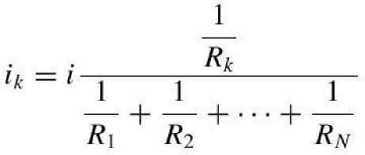
Voltage and Current division: Page 37
The current flowing through R2 is
or
An illustration of current division. | For a parallel combination of N resistors, the current through Rk is
37

Slide 38
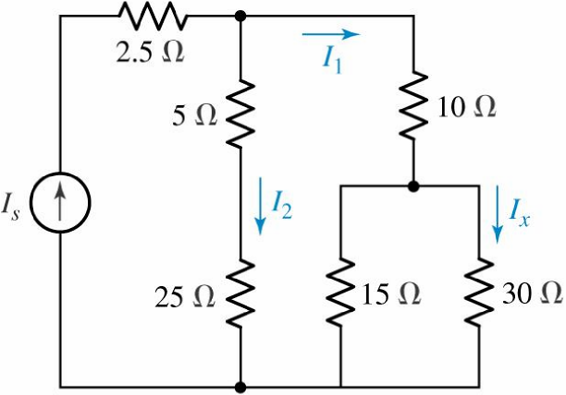
Example:
Determine the current I_{x} if
I₁ = 100 mA.
38

Slide 39
Practice:
39

Slide 40
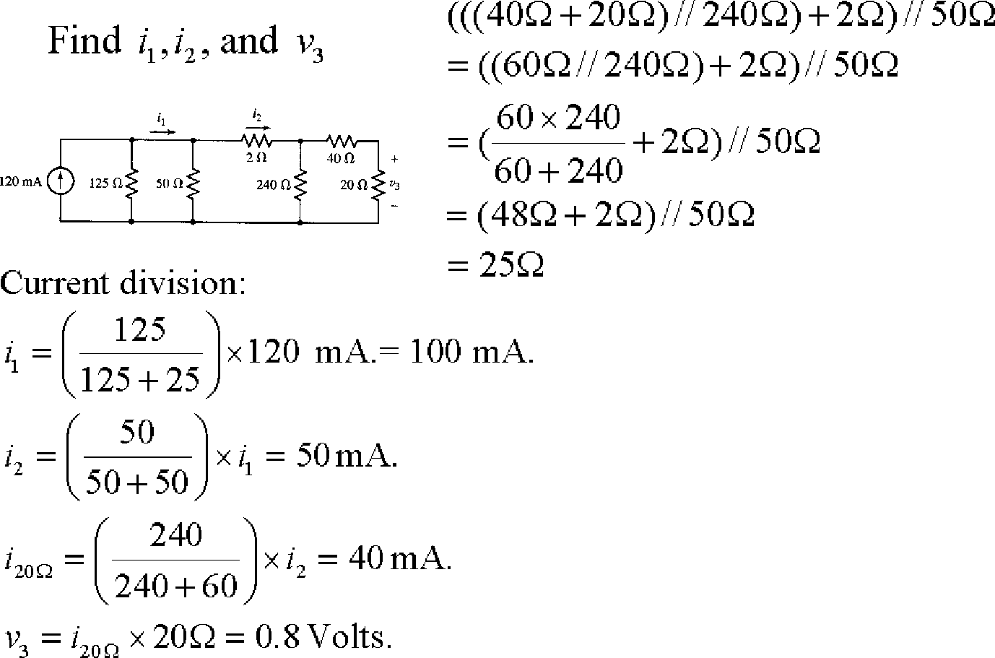
Example:
40

