Slide 1
Chapter 7:
Capacitors and Inductors
1

Slide 2
Objectives :
the voltage-current relationship of ideal capacitors
the voltage-current relationship of ideal inductors
the energy stored
series/parallel combinations of capacitors
series/parallel combinations of inductors
2

Slide 3
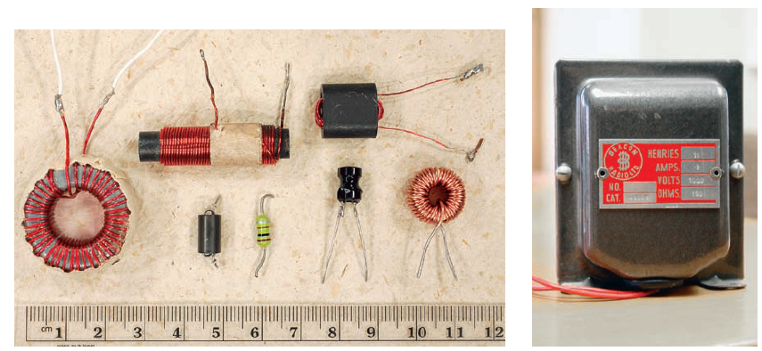
Introduction:
Both the inductor and the capacitor are passive
elements that are capable of storing and
delivering finite amount of energy.
3

Slide 4
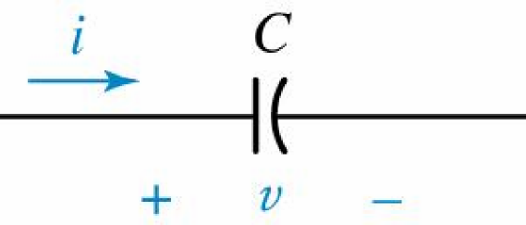
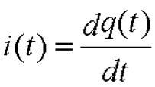
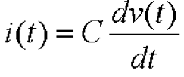
The Capacitors:
Electrical symbol and
current-voltage
conventions for a
capacitor.
Capacitor: C
Unit : Farad (F)
4

Slide 5
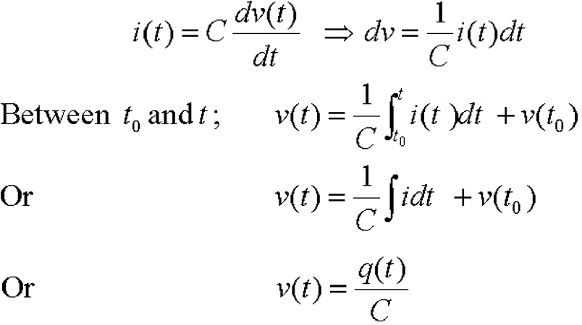
Voltage-Current Relationships:
5

Slide 6
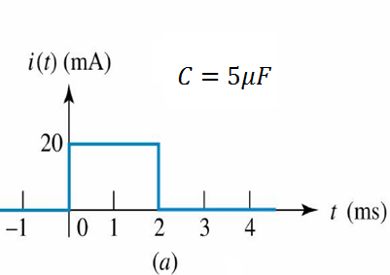
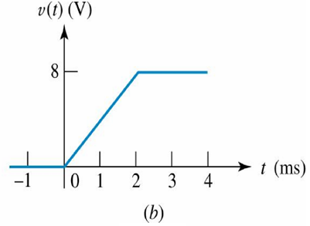
Example 7.1:
Find the capacitor voltage that is associated with the current
shown graphically below.
6

Slide 7
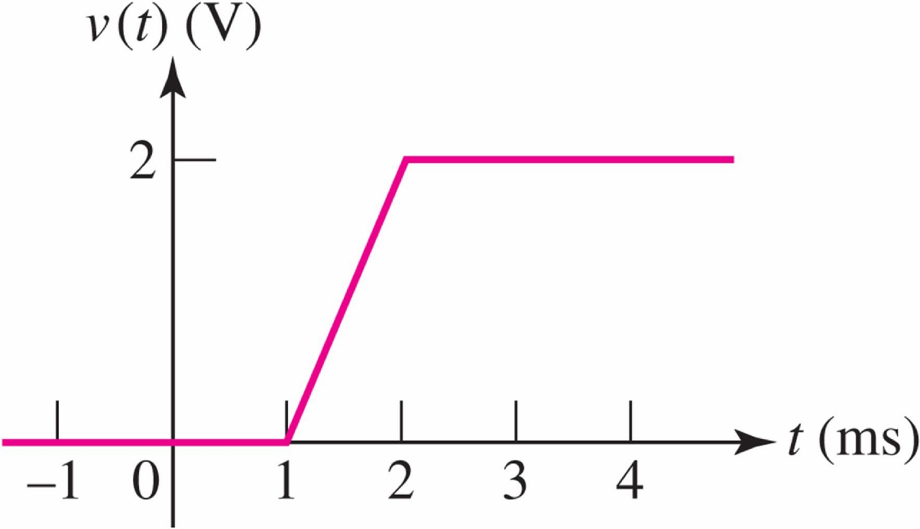
Practice: 7.1
Determine the current through a 100-p F capacitor if its
voltage as a function of time is given by the figure
7

Slide 8
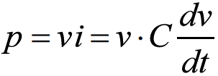
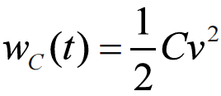
Energy Storage:
The power delivered to a capacitor is
The energy stored in its electric field is therefore
And thus
If we select a zero energy reference at t0
8

Slide 9
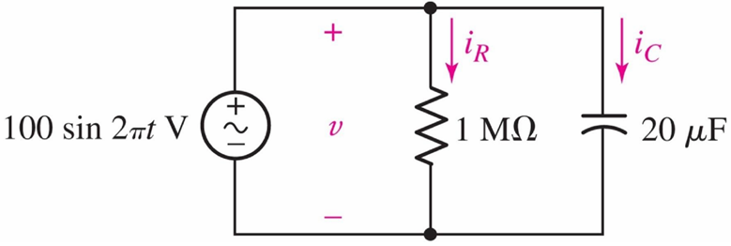
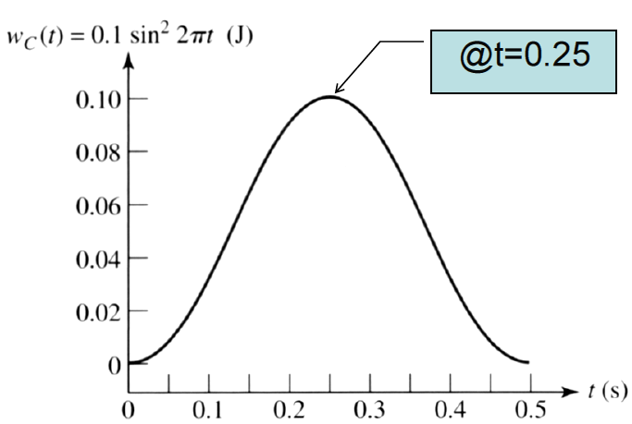
Example: 7.2
Find the maximum energy stored in the capacitor and the energy dissipated in the resistor over the interval 0 < t < 0.5s
9

Slide 10
Example: 7.2
The energy dissipated in the resistor is
10

Slide 11
Practice: 7.2
11

Slide 12
Characteristics of an Ideal Capacitor:
There is no current through a capacitor if the voltage across it is not changing with time. A capacitor is therefore an open circuit to dc.
A finite amount of energy can be stored in a capacitor even if the current through the capacitor is zero, such as when the voltage across it is constant.
It is impossible to change the voltage across a capacitor by a finite amount in zero time, for this requires an infinite current through the capacitor.
A capacitor never dissipates energy, but only stores it. Although this is true for the mathematical model, it is not true for a physical capacitor due to finite resistances.
12

Slide 13
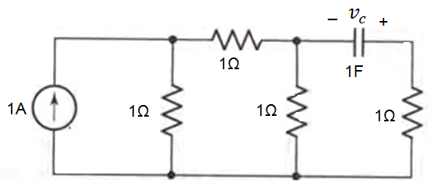
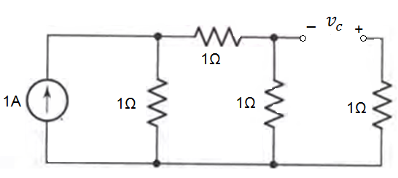
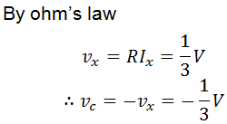
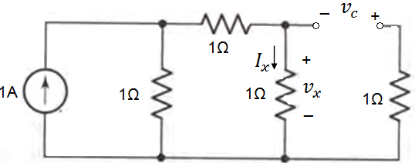
Example: Capacitor with D.C. source
Compute the voltage across the capacitor
13

Slide 14
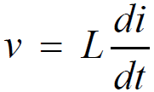
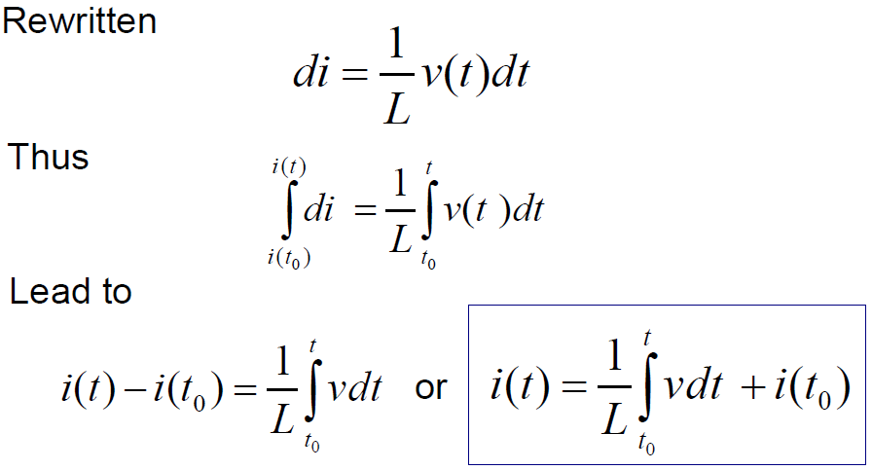
Electrical symbol and current-voltage conventions for an inductor.
The Inductor:
Inductor symbol: L
Unit : Henries (H)
14

Slide 15
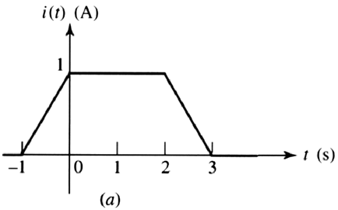
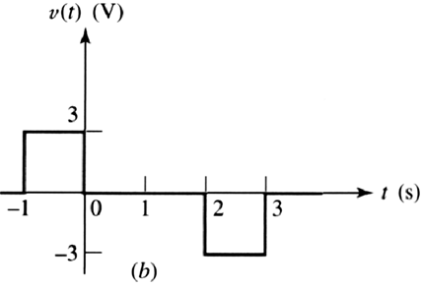
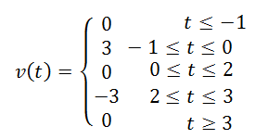
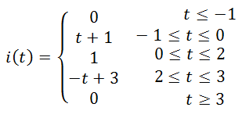
Example: 7.4
Given the waveform of the current in a 3-H inductor as shown, determine the inductor voltage and sketch it.
15

Slide 16
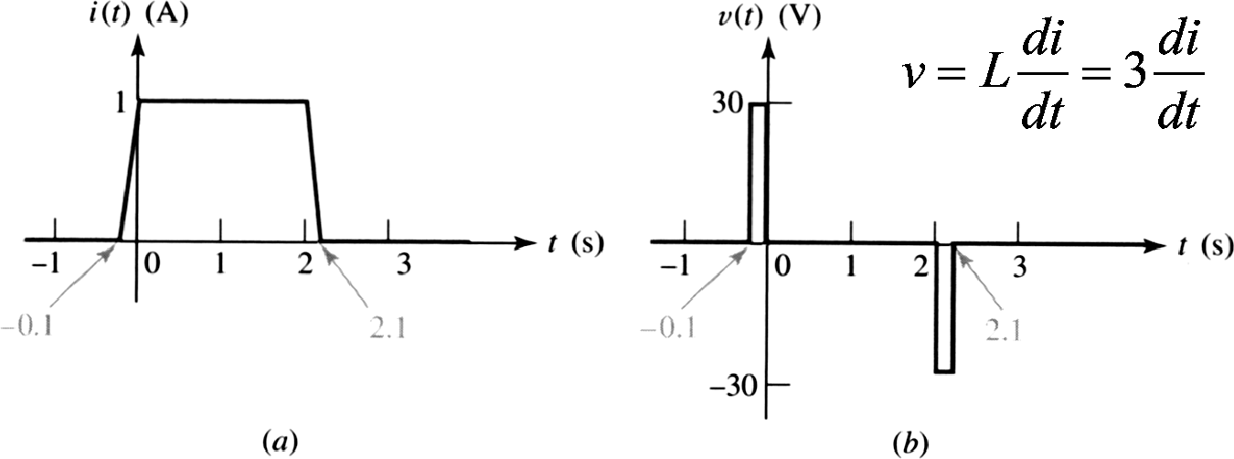
Example: 7.5
Given the waveform of the current in a 3-H inductor as shown, determine the inductor voltage and sketch it.
16

Slide 17
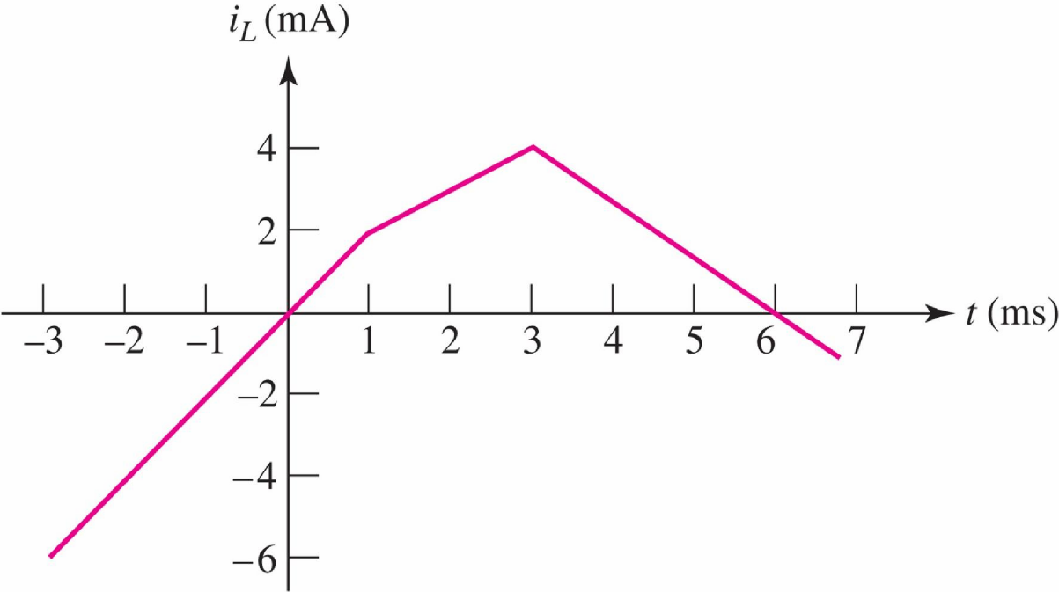
Practice: 7.4
The current through a 0.2-H inductor is shown in the
figure. Assume the passive sign convention, and find
at t equal to: (a) 0; (b) 2 ms; (c) 6 ms.
17

Slide 18
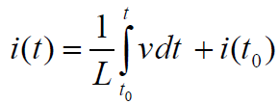
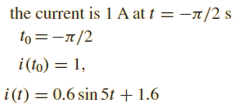
Example: 7.6
18

Slide 19
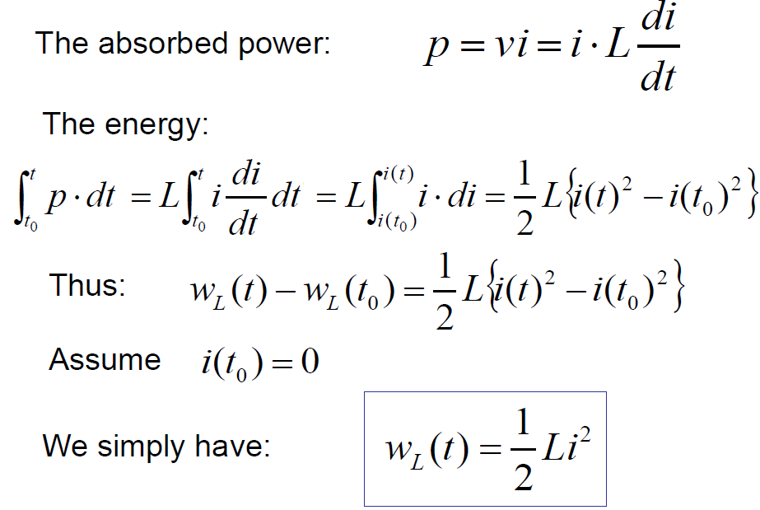
Energy Storage:
19

Slide 20
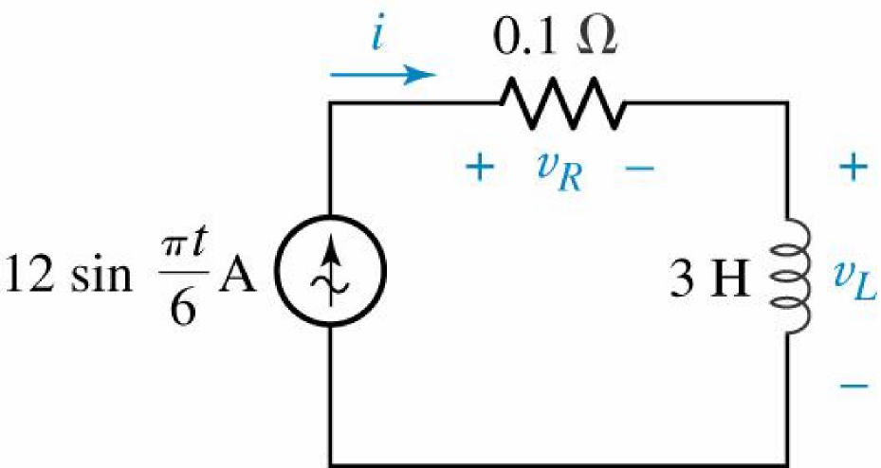
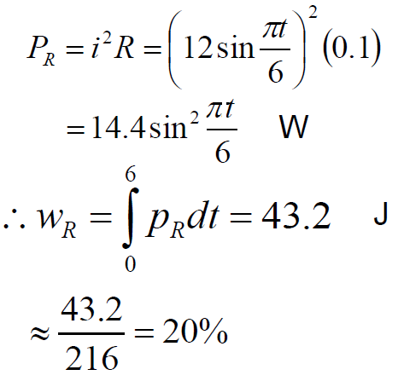
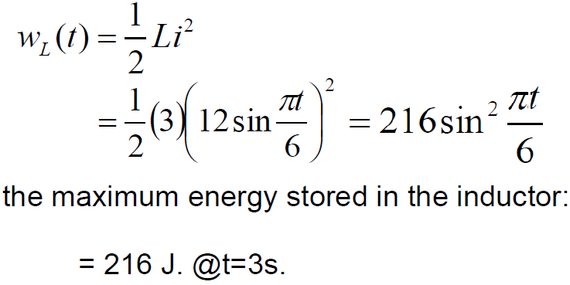
Example: 7.7
find the maximum energy stored in the inductor and calculate how much energy is dissipated in the resistor in the time during which the energy is being stored in and then recovered from the inductor
20

Slide 21
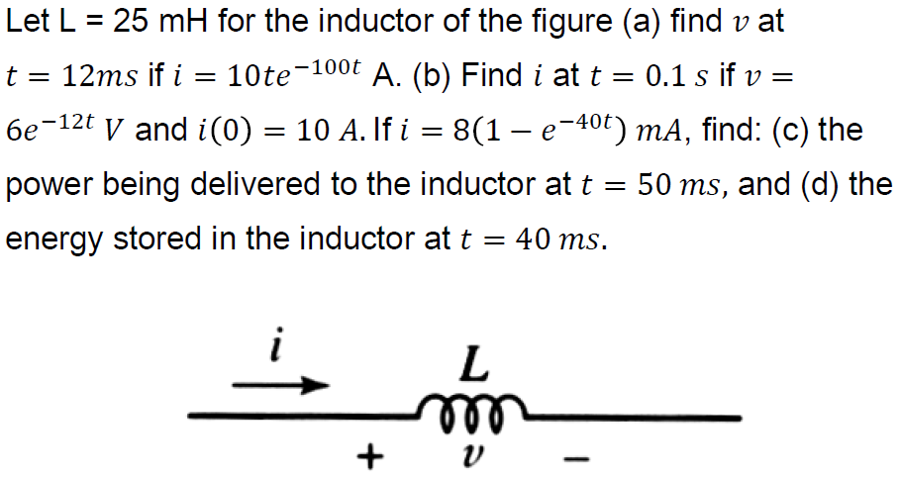
Practice: 7.7
21

Slide 22
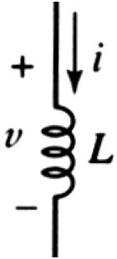
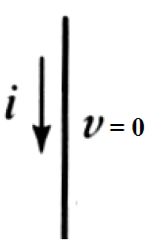
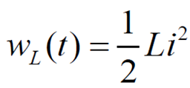
Characteristics of an Ideal Inductor:
There is no voltage across an inductor if the current through it is not changing with time. An inductor is therefore a short circuit to dc.
A finite amount of energy can be stored in an inductor even if the voltage across the inductor is zero, such as when the current through it is constant.
It is impossible to change the current through an inductor by a finite amount in zero time.
The inductor never dissipates energy, but only stores it. Although this is true for the mathematical model, it is not true for a physical inductor due to series resistances.
22

Slide 23
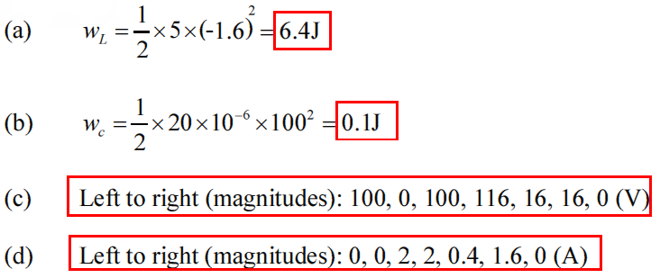
Example:
23

Slide 24
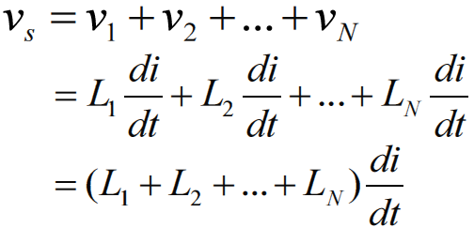
Inductance Combinations:
(a) N inductors connected in series; (b) equivalent circuit;
24

Slide 25
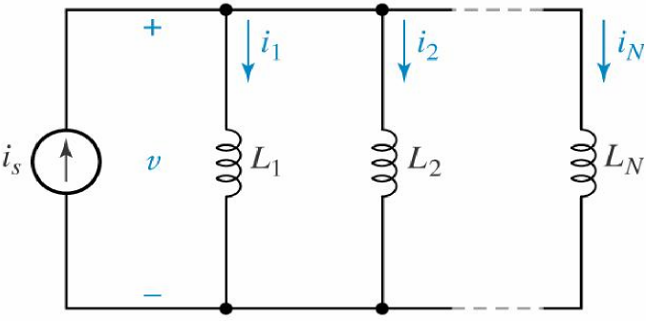
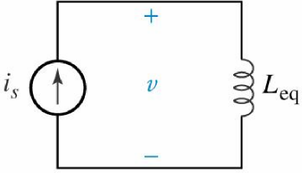
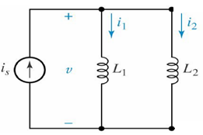
Inductance Combinations:
N inductors connected in parallel;
equivalent circuit for circuit in
Special case: two inductors connected in parallel;
25

Slide 26
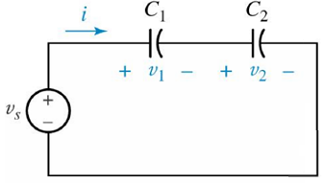
Capacitance Combinations:
(a) N capacitors connected in series; (b) equivalent circuit;
Special case: two capacitors connected in series;
26

Slide 27
Capacitance Combinations:
(d)
(c)
(c) N capacitors connected in parallel; (d) equivalent circuit to (c).
27

Slide 28
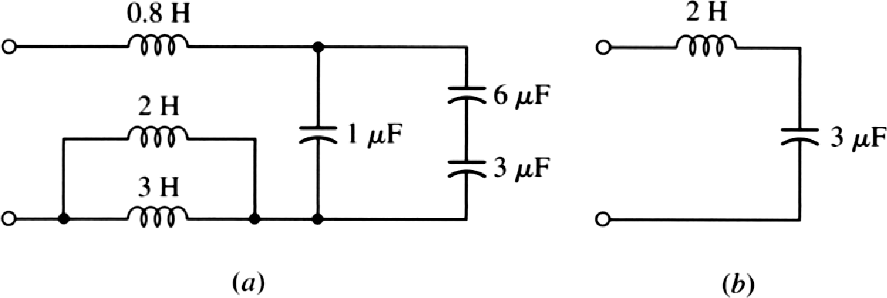
Example: 7.8
simplify the network using series/parallel combinations.
The 6 μF and 3 μF series capacitors are first combined into a 2 μF
equivalent, and this capacitor is then combined with the 1 μF element
with which it is in parallel to yield an equivalent capacitance of 3 μF.
In addition, the 3 H and 2 H inductors are replaced by an equivalent
1.2 H inductor, which is then added to the 0.8 H element to give a total equivalent inductance of 2 H.
28

Slide 29
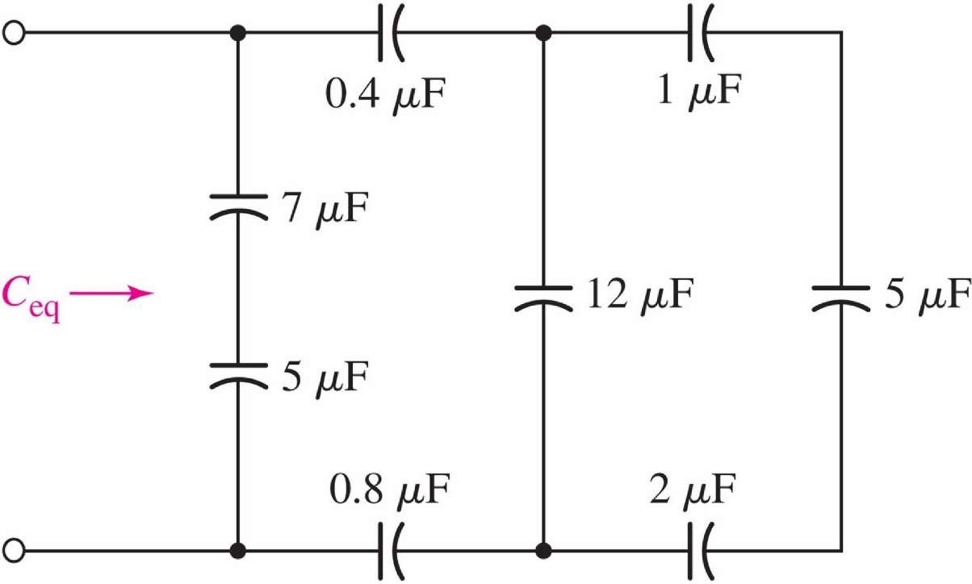
Practice: 7.5
29

Slide 30
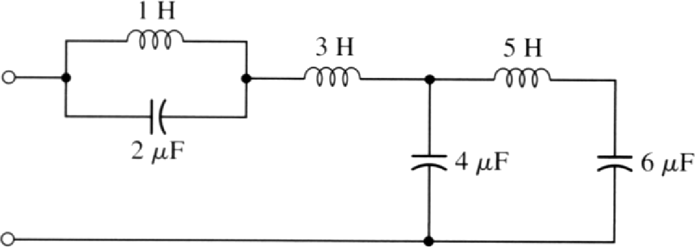
Note:
No series or parallel combinations of either the
inductors or the capacitors can be made
30

Slide 31
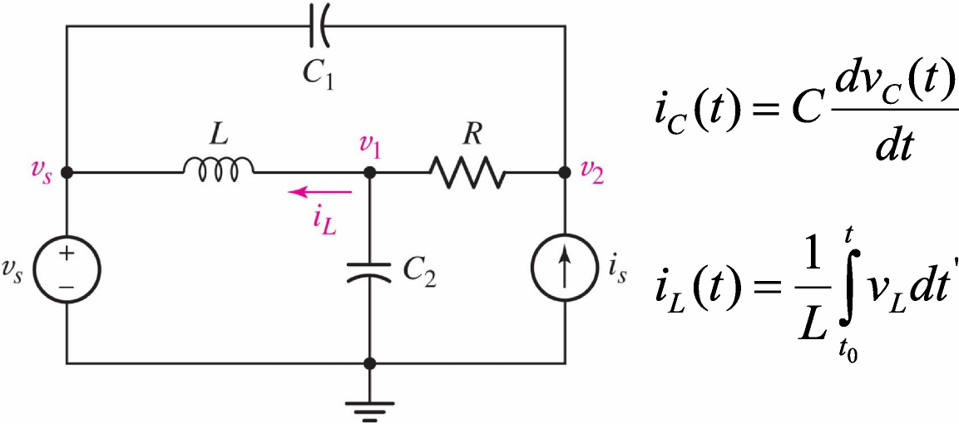
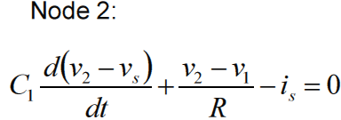
Consequences of Linearity:
There will be constant-coefficient linear integrodifferential equations
Example: write appropriate nodal equations for the circuit
31

