Slide 1
Chapter 8:
Basic RL and RC Circuits
1

Slide 2
Objectives :
time constants for RL and RC circuits
the natural and forced response
the total response
the effect of initial conditions on circuit
response
RL and RC circuit response
2

Slide 3
Response of the circuit:
A natural response: this response depends upon the general “nature’’ of the circuit (the types of elements, their sizes, the interconnection of the elements).
A transient response:any real circuit we construct cannot store energy forever; the resistances intrinsically associated with inductors and capacitors will eventually convert all stored energy into heat. The response must eventually die out, and for this reason it is frequently referred to as the transient response.
A forced response: consider independent sources acting on a circuit, part of the response will resemble the nature of the particular source (or forcing function) used; this part of the response, called the particular solution, the steady-state response, or the forced response.
3

Slide 4
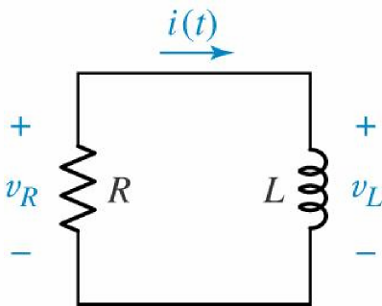
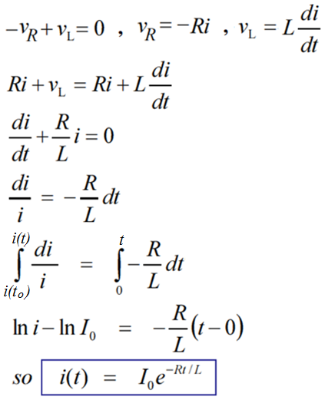
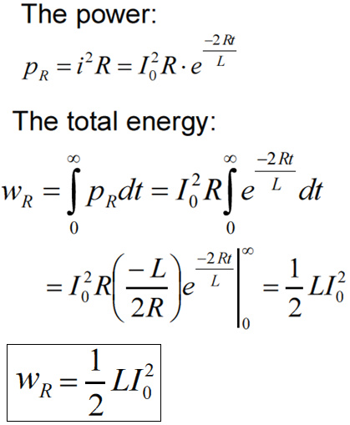
The Source-Free RL Circuit:
A series RL circuit for which i(t) is to be determined, subject to the initial condition that i (0) = I0
4

Slide 5
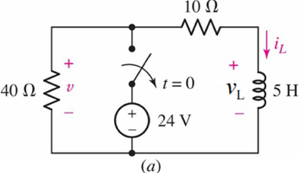
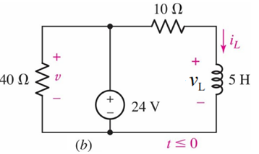
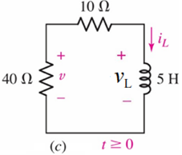
Example 8.2:
Find the current and voltage through the 5-H inductor at t = 200ms
5

Slide 6
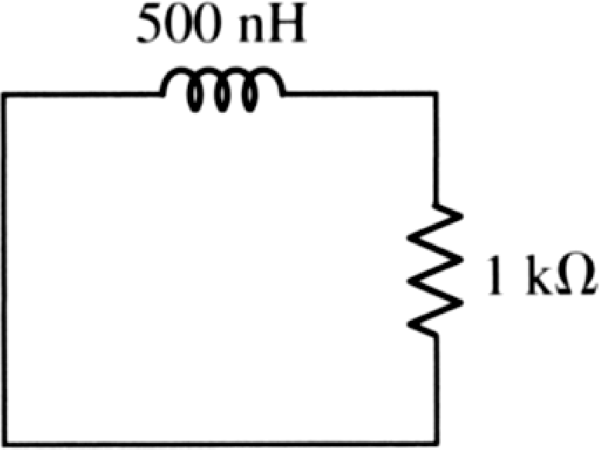
Practice:
Determine the energy remaining in the inductor at t = 2 ns if it is initially storing 7 µJ
6

Slide 7
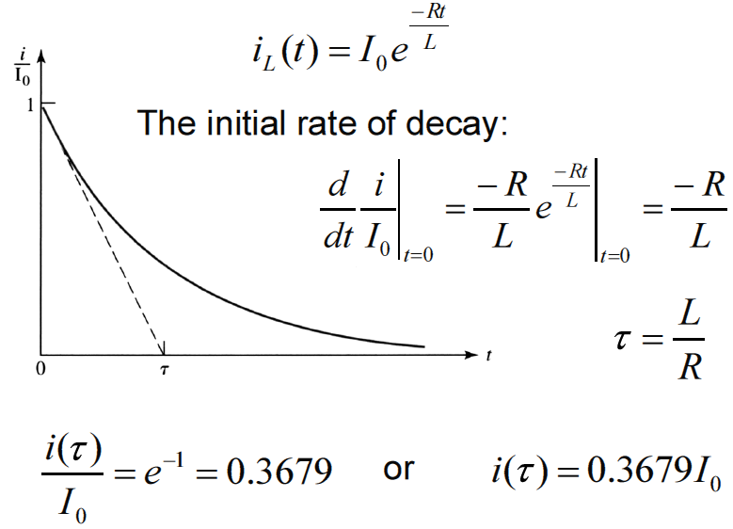
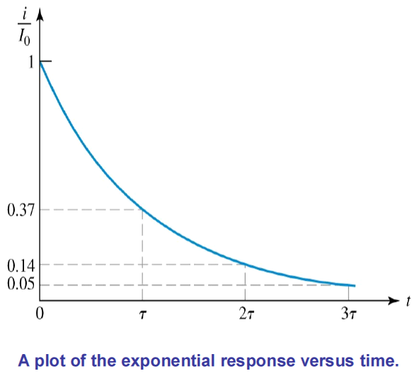
Properties of the Exponential response:
7

Slide 8
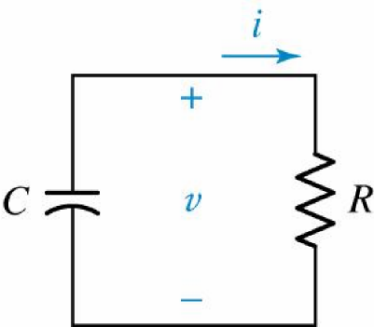
The Source-Free RC Circuit:
A parallel RC circuit for which
v(t) is to be determined,
subject to the initial condition that v(0) = V0.
8

Slide 9
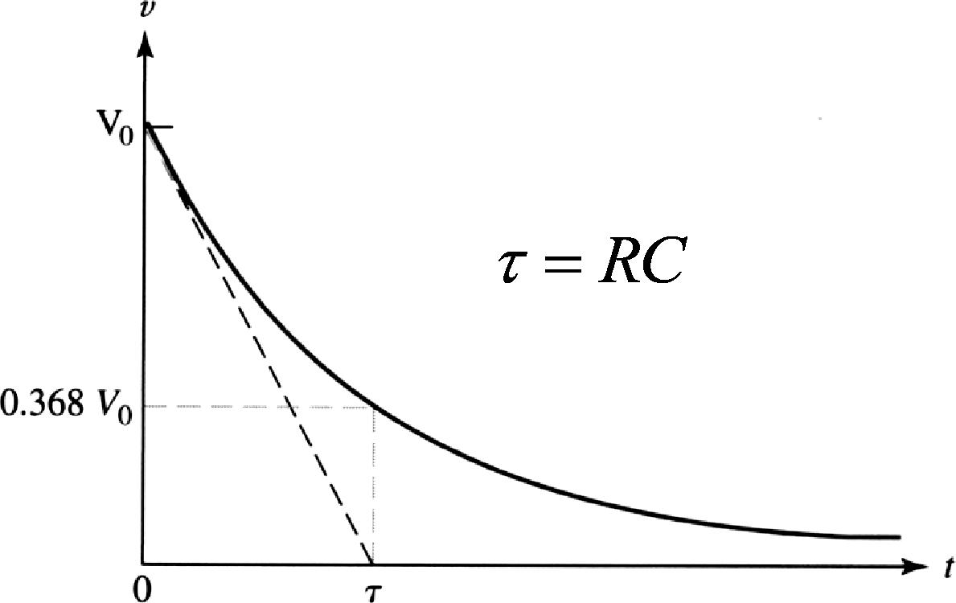
The Source-Free RC Circuit:
9

Slide 10
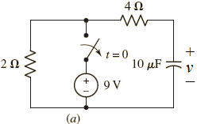
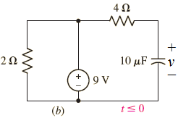
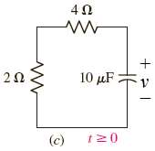
Example 8.3:
For the circuit shown, find the voltage labelled v at t = 200 μs.
10

Slide 11
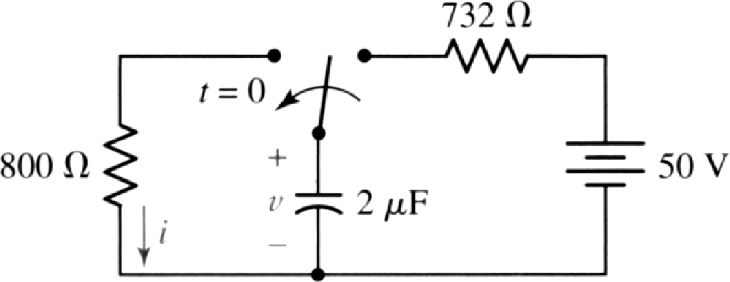
Practice 8.4:
11

Slide 12
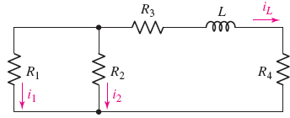
General RL circuits:
consider the circuit shown, assume that some finite amount of energy is stored in the inductor at t = 0, so that iL (0) ≠ 0. given the initial value of i1 as i1(0+), find i1 , i2 and iL
12

Slide 13
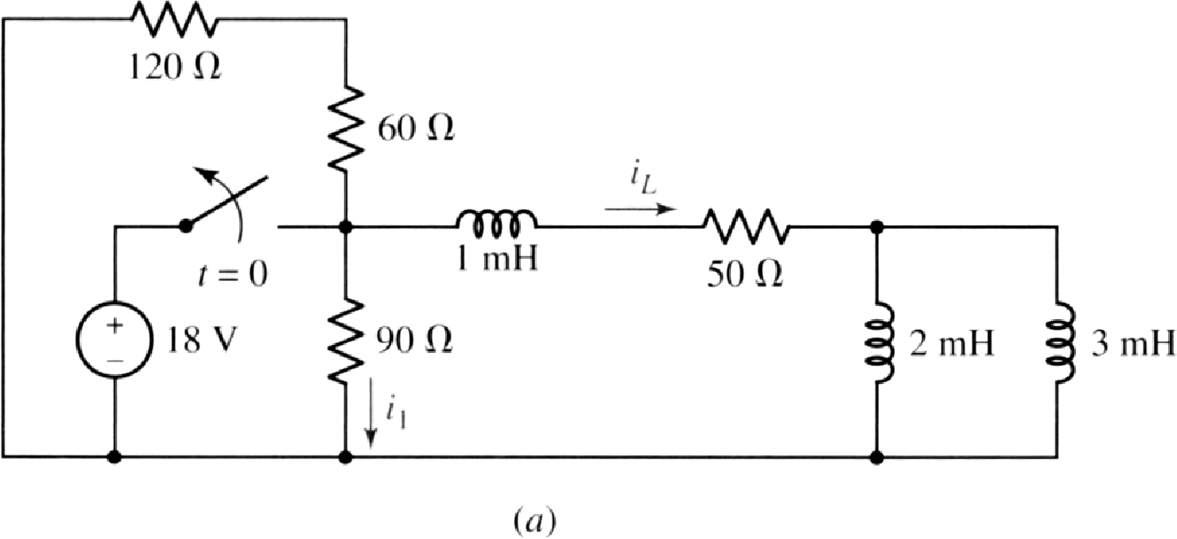
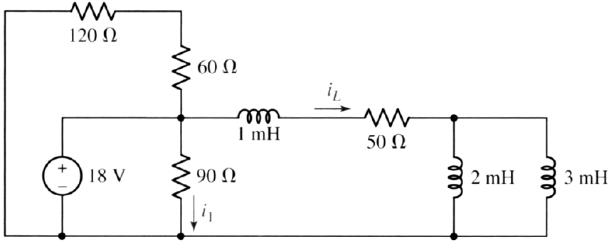
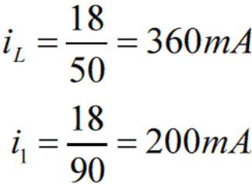
Example 8.4:
determine both i1 and iL in the circuit
13

Slide 14
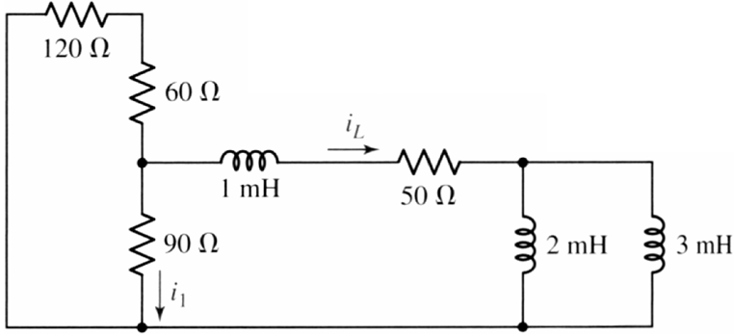
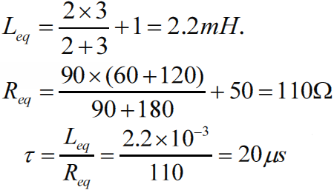
Example 8.4:
14

Slide 15
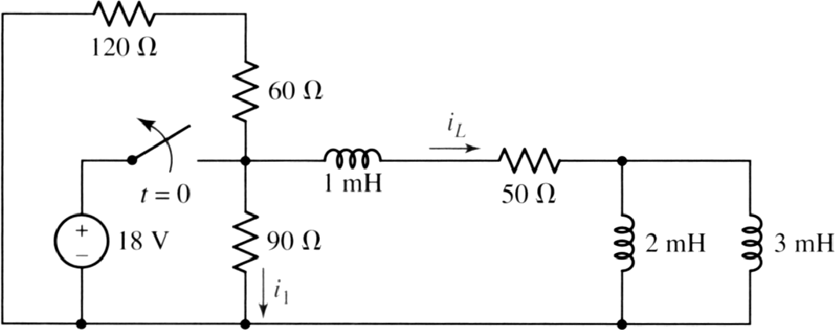
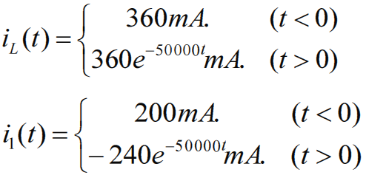
Example 8.4:
determine both i1 and iL in the circuit
15

Slide 16
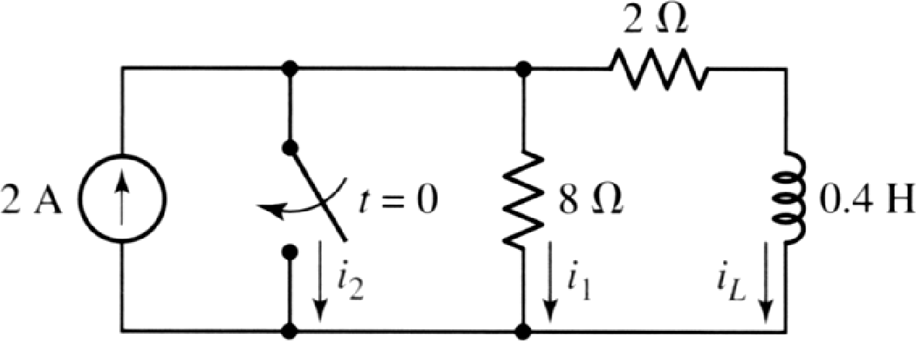
Practice 8.5:
at t = 0.15s. find the value of iL, i1, i2
16

Slide 17
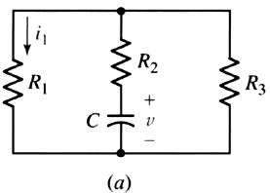
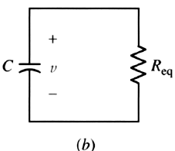
General RC circuits
17

Slide 18
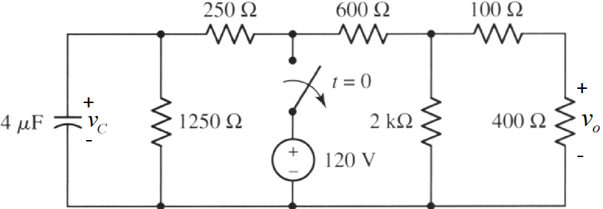
Practice 8.6:
18

Slide 19
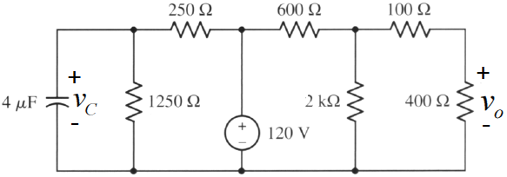
Practice 8.6:
19

Slide 20
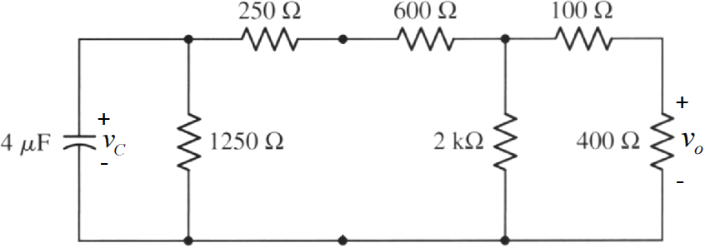
Practice 8.6:
20

Slide 21
Practice 8.6:
21

Slide 22
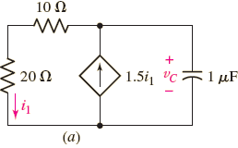
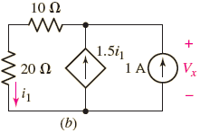
Example 8.6:
For the following circuit, find vc for t > 0 if vc(0-) = 2V
22

Slide 23
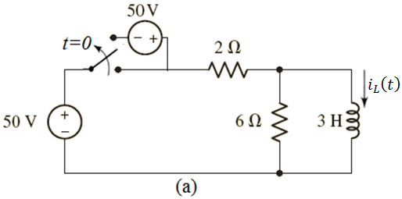
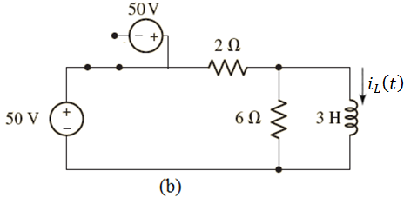
Driven RL Circuits: Example 8.8:
Determine and plot i(t) for all values of time in the circuit
23

Slide 24
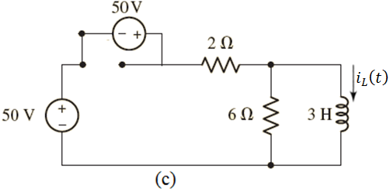
Driven RL Circuits: Example 8.8:
Determine and plot i(t) for all values of time in the circuit
24

Slide 25
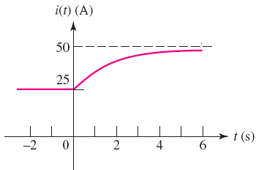
Driven RL Circuits: Example 8.8:
Determine and plot i(t) for all values of time in the circuit
25

Slide 26
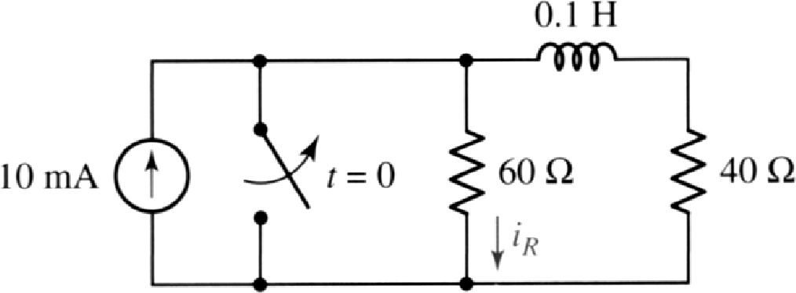
Driven RL Circuits: Practice 8.11:
26

Slide 27
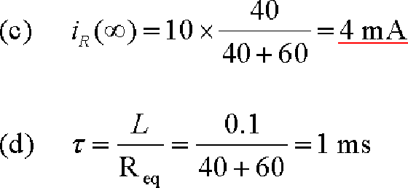
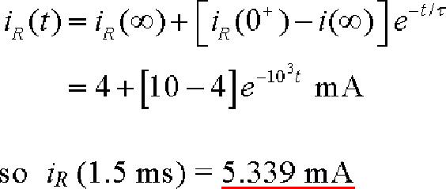
Driven RL Circuits: Practice 8.11:
27

Slide 28
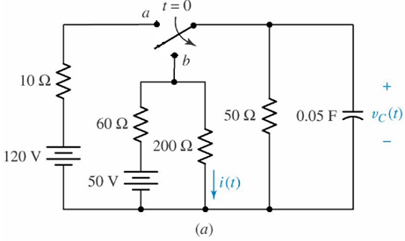
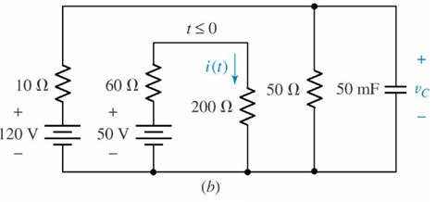
Driven RC Circuits: Example 8.10
Find the capacitor voltage vC(t) and the current i(t) in the 200Ω resistor of the circuit shown in (a).
28

Slide 29
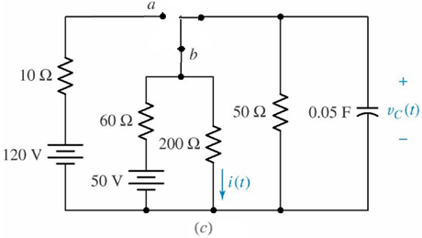
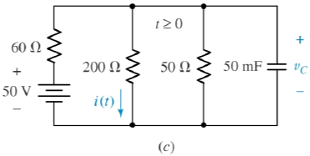
Driven RC Circuits: Example 8.10
29

Slide 30
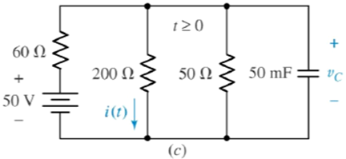
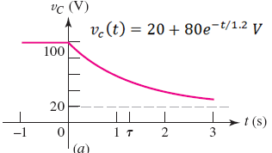
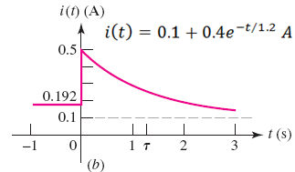
Driven RC Circuits: Example 8.10
30

Slide 31
Practice: 8.12
31

Slide 32
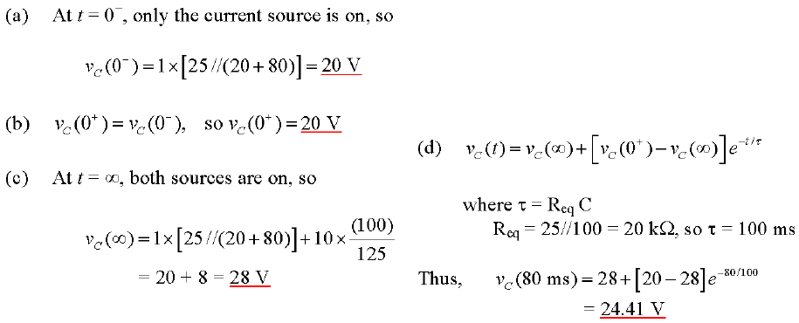
Practice: 8.12
32

