Slide 1
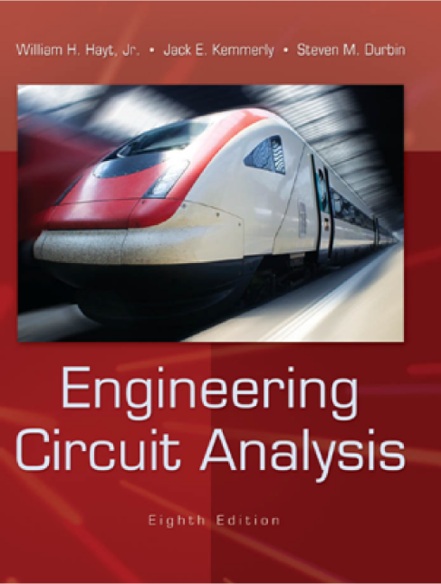
Fundamental of Electrical circuits

Slide 2
Course Description:
Electrical units and definitions: Voltage, current, power, energy, circuit elements: resistors, capacitors, inductors, independent and dependent sources.
Circuit Theory and analysis methods: Kirchhoff’s Laws, voltage and current divider, node and mesh analysis, Thevenin and Norton theorem, maximum power transfer, superposition theorem.
Sinusoidal Steady State Analysis: sinusoid properties, complex number representations, phasors, circuit theory and analysis method in AC circuits.

Slide 3
Textbook:
William H. Hayt, Jr., Jack E. Kemmerly, Steven
M. Durbin “Engineering Circuit Analysis”,
Eighth edition, McGraw-Hill.

Slide 4
Chapter 1: Introduction
Circuit theory:
A field as diverse as electrical engineering
Electric circuits: common for EE. :
A mathematical model, which approximates the behavior of an actual electric system

Slide 5
Overview:
Linear circuit analysis:
Resistive circuit analysis: introduce a number of very powerful techniques, such as nodal analysis, mesh analysis, superposition, etc.
time-domain analysis: allow capacitors and inductors to be included in a circuit.
frequency-domain analysis: transform differential equations into more easily managed algebraic equations.

Slide 6
Relationship:
Relationship of Circuit Analysis to Engineering:
Learning how to analyze a problem.
To learn how to
•To be methodical
•To determine the goal of a particular problem
•To work with the information given to develop a plan of attack
•To implement the plan to obtain a solution
•To verify that the proposed solution is accurate

Slide 7
Analysis and Design:
This text is focused on developing our ability to analyze and solve problem.
Developing our design skills comes less naturally to us than developing our analytical skills.

Slide 8
Computer-Aided Analysis:
Modern circuit analysis software is rapidly increasing in its level of integration.
We need to have a solid understanding of how circuits work in order to develop an ability to design them.

Slide 9
Problem-Solving:
A suggested problem- solving flow chart

Slide 10
Problem-Solving:
Develop the skills to successfully attack the
unsolved problems
Identify what’s given and what’s to be found
Sketch a circuit diagram or other visual model
label, reference, redraw to simple form
simplified
Think of several solution methods and a way of choosing among them
Calculate a solution
paper and pencil
calculator
Use your creativity
Test your solution

Slide 11
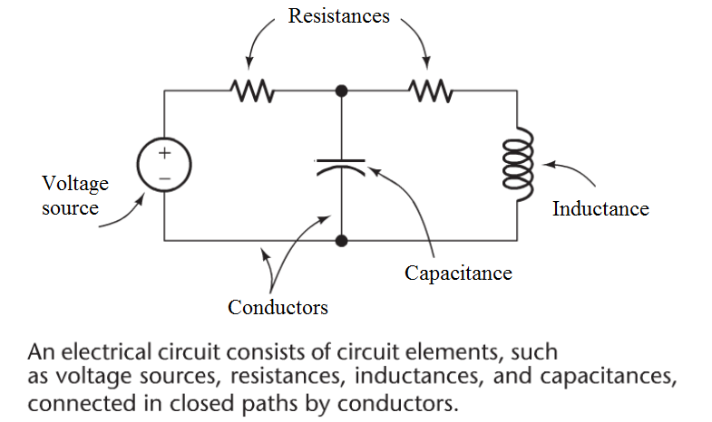
Chapter 2:
Basic Components and Electric Circuits

Slide 12
Objectives:
Definition of basic electrical quantities and associated units
The relationship between charge, current, voltage, and power
The passive sign convention
Dependent and independent voltage and current sources
The behavior of the resistor and Ohm’s law

Slide 13
Units and Scales:
In order to state the value of some measurable quantity, we must
give both a number and a unit, such as “3 meters.
The most frequently used system of units is the International
System of Units (abbreviated SI in all languages).
TABLE :2.1 SI Base Units
Base Quantity length | Name meter | Symbol m
mass | kilogram | kg
time electric current thermodynamic temperature amount of substance | second ampere kelvin mole | s A K mol
luminous intensity | candela | cd
The fundamental unit of work or energy is the joule (J). One joule = in SI base units)
The fundamental unit of power is the watt (W), defined as 1 J/s.

Slide 14
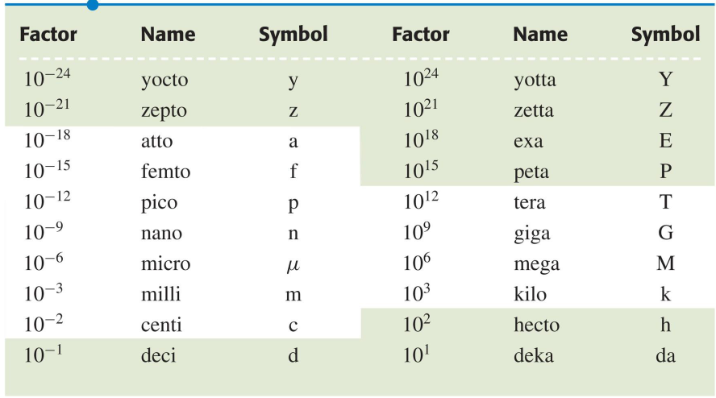
Units and Scales:
TABLE 2.2 SI Prefixes

Slide 15
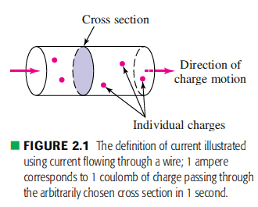
Charge:
There are two types of charge:
positive (corresponding to a proton) and
negative (corresponding to an electron).
the fundamental unit of charge is the coulomb (C).
It is defined in terms of the ampere by counting the total charge that
passes through an arbitrary cross section of a wire during an interval of
one second; one coulomb is measured each second for a wire carrying
a current of 1 ampere (Fig. 2.1).
In this system of units, a single electron has a charge of
and a single proton has a charge of
A quantity of charge that does not change with time
is typically represented by Q.
The instantaneous amount of charge
(which may or may not be time-invariant)
is commonly represented by q(t), or simply q.

Slide 16
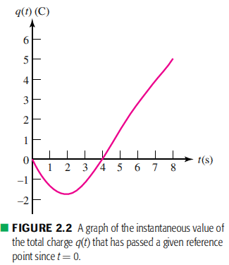
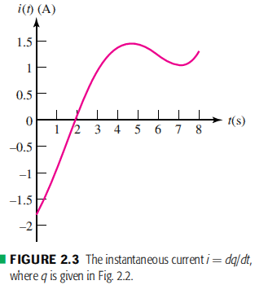
Current:
Electrical current is the time rate of flow of electrical charges through a
conductor or circuit element.
Current is symbolized by I or i , and so
The unit of current is the ampere (A), It is commonly abbreviated as an
“amp,”.
One ampere equals 1 coulomb per second. (A=C/s).
The charge transferred between time tₒ and t
may be expressed as a definite integral:
The total charge transferred
over all time is thus given by

Slide 17
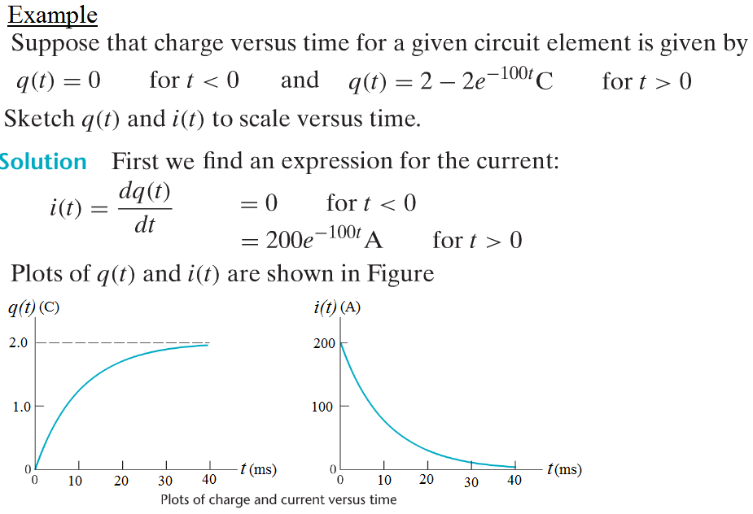
Current:

Slide 18
Current:
Two different methods of labeling the same current.
(a, b) Incomplete, improper, and incorrect definitions of a current.
(c) the correct definition of i₁(t).

Slide 19
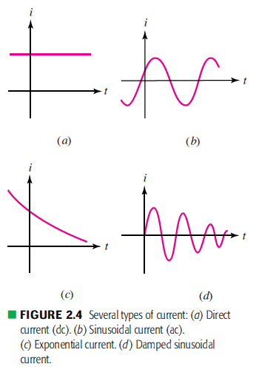
Current:

Slide 20
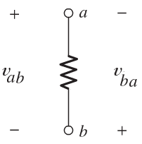
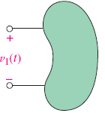
Voltage:
An electrical voltage (or a potential difference) exists between two
terminals is a measure of the work required to move charge
through the element.
The unit of voltage is the volt (V), and 1 volt is the same as 1 J/C.
Voltage is represented by V or v.
A voltage can exist between a pair of electrical terminals whether a
current is flowing or not.
Voltages are assigned polarities that indicates the direction of
energy flow.
The voltage is indicated by a plus-minus pair of algebraic signs.

Slide 21
Voltage:
(a, b) These are inadequate definitions of a voltage. (c) A correct definition includes both a symbol for the variable and a plus- minus symbol pair.
(a, b) Terminal B is 5 V positive with respect to terminal A; (c, d) terminal A is 5 V positive with respect to terminal B.

Slide 22
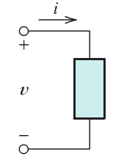
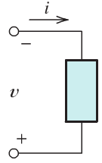
Power:
It is represented by P or p.
Its unit is watts (W)
Passive sign convention
If a positive current is entering a positive terminal of
an element, then the energy is supplied to the element
(or the element absorbs the power).
If a positive current is entering a negative terminal of
an element, then the energy is supplied by the element
(or the element generates the power).

Slide 24
Power:
Compute the power absorbed by each part.

Slide 25
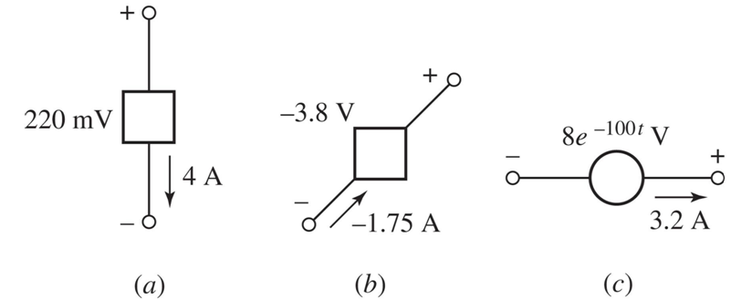
Power:
Compute the power delivered by each part.

Slide 26
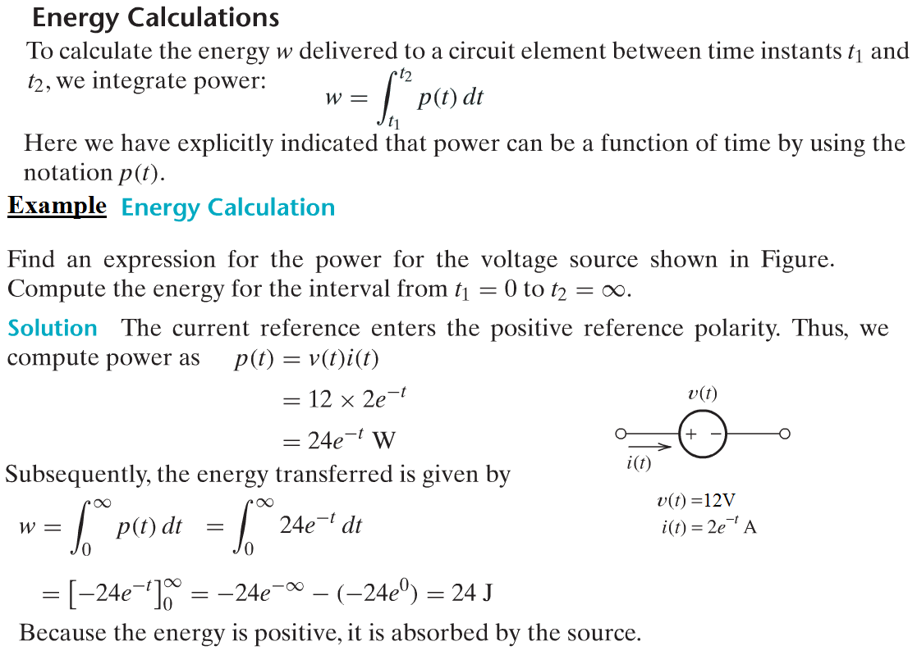
Energy calculation:

Slide 27
Sources:
Symbol for an independent current source.
Symbol for independent voltage source: (a) DC voltage source;
(b) battery; (c) ac voltage source.
The four different types of dependent sources:
current-controlled current source; (CCC)
voltage-controlled current source; (VCC)
voltage-controlled voltage source; (VCV)
current-controlled voltage source. (CCV)

Slide 28
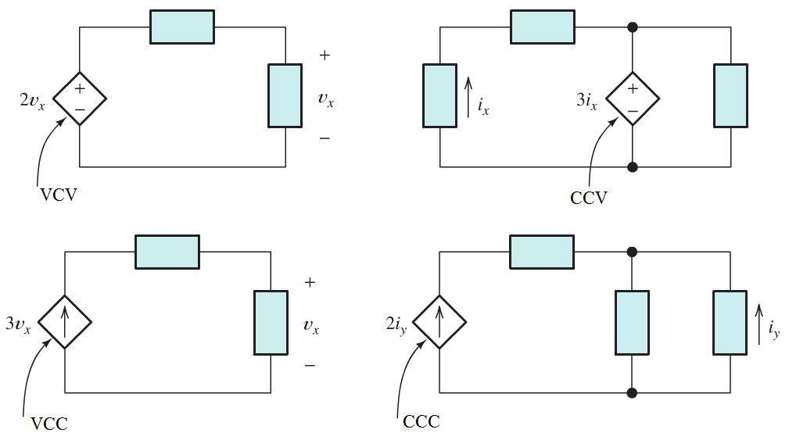
Dependant sources

Slide 29
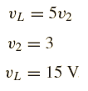
Example:
In the circuit below ,if v₂ is known to be 3 V, find v_{L} .

Slide 30
Example:
Find the power ofeach element in the circuit below.

Slide 31
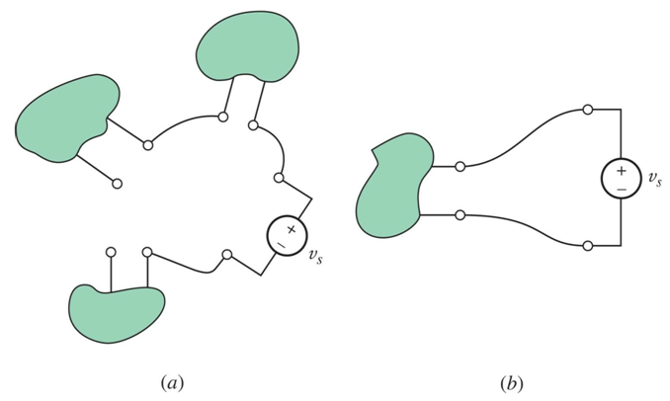
Network and Circuits:
The interconnection of two or more simple circuit elements forms and electrical network. If the network contains at least one closed path, it is also an electric circuit.

Slide 32
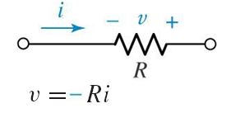
Ohm’s Law:
Ohm’s law states that the voltage across conducting materials is directly proportional to the current flowing through the material
where the constant of proportionality R is called the resistance. The unit of
resistance is the ohm, which is 1 V/A and customarily abbreviated by a
capital omega, Ω.

Slide 33
Ohm’s Law:
passive element: R, L, C
active element: sources

Slide 34
Example:

Slide 35
Homework:
Determine the power being absorbed by each of the circuit elements shown

